Slide 1
Quartz Resonator Summary
Seongwoo Oh

Slide 2
CAD drawings (file information)
I took the existing design from "hangerdesign" folder within "resonatortestchips" within "Fabrication" within "FelixSchupp" on "jplabserver."
The name of the original file is "MUL_T5_NbEtch_2x_xor_FJS_15x15_v2."
I modified the length and geometry for different amounts of capacitive coupling.
My revised drawing is now stored in "quartz crystal project" folder within "SeongAutocad" within "Seong" on "jplabserver".
Previously, λ/4 resonators were made on float-zone(FZ) Si wafers with a high resistivity and (1 0 0) crystal orientation before but I wasn’t able to find designed Q and designed f calculations previously done.

Slide 3
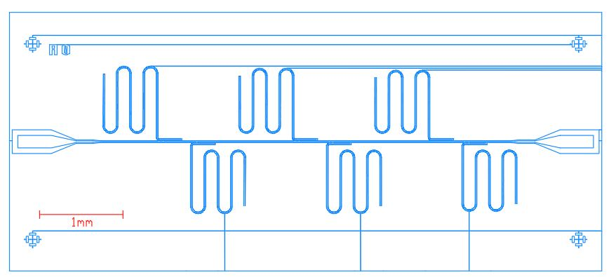
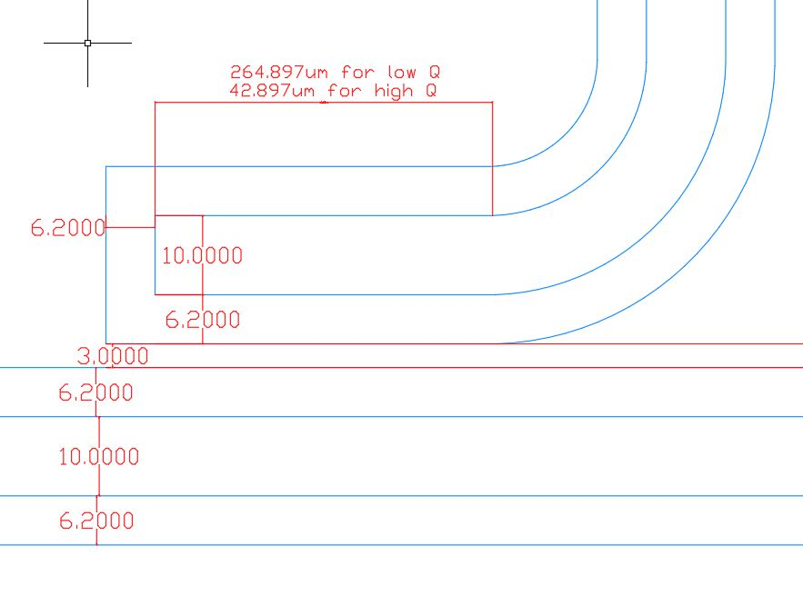
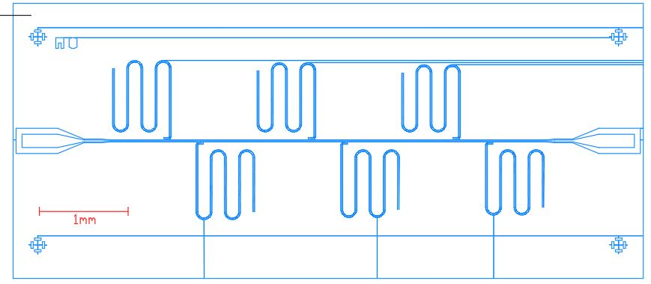
CAD drawings (dimensions)
Higher capacitive footprint
-> Low Q resonator
Width:3.1mm
length: 7.1mm
Lower capacitive footprint
-> High Q resonator
Chip size: diced into 7.1 x 3.1mm

Slide 5
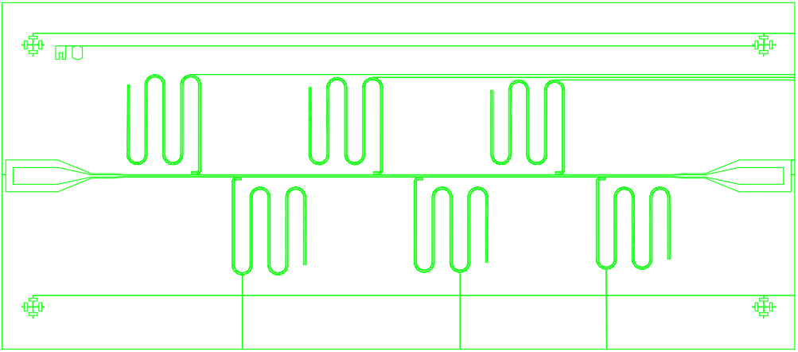


Slide 6
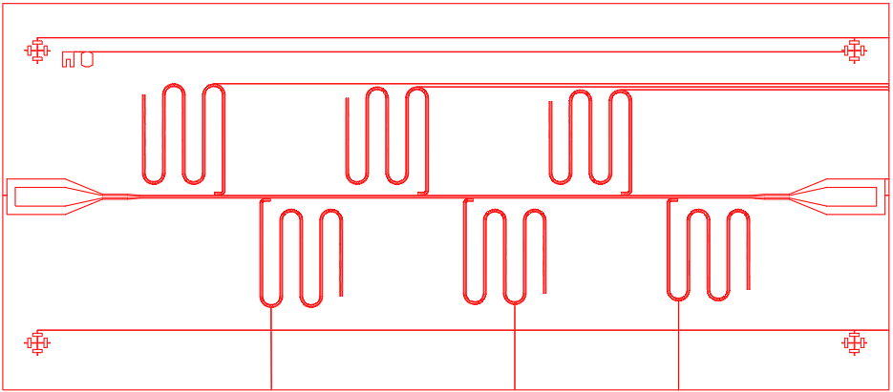
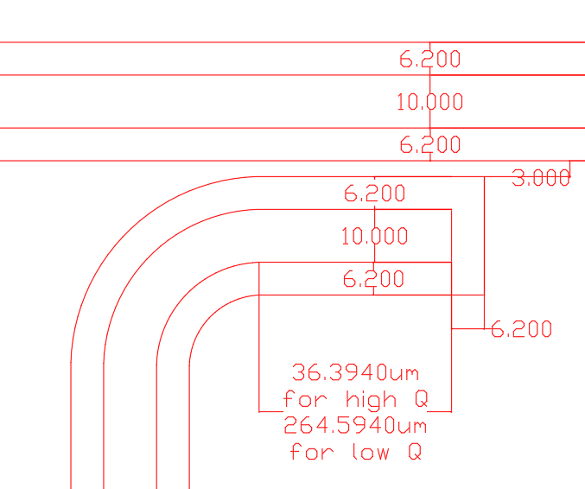

Slide 7
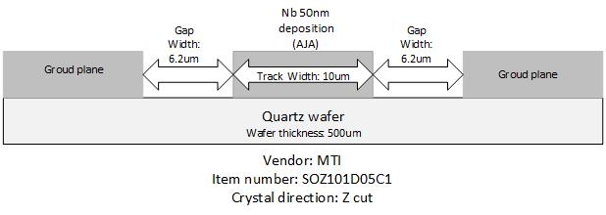
CAD drawings (dimensions)
Both transmission line and λ/4 resonator have the cross sectional dimensions shown below.
The dimensions are chosen to give
Z0 = 50Ω characteristic impedance for silicon (ε_{r}=11.7).
For quartz (ε_{r}=3.7), the dimensions specified above lead to Z0 = 83.69Ω characteristic impedance.
(characteristic impedance calculation based on the geometry and dielectric constant was done with
‘Coplanar Waveguide With Ground Characteristic Impedance Calculator’ on the CHEMANDY ELECTRONICS website.
Perhaps, an even bigger characteristic impedance is desirable for greater E field and hence greater coupling strength.

Slide 8
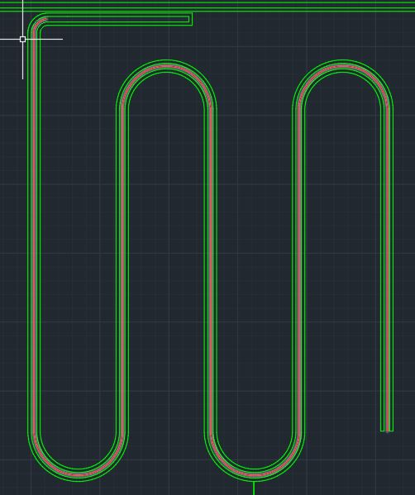
CAD drawings (dimensions)
Lengths of the resonators are determined by lines drawn at the center of the center stripline and calculating the total length of the lines in AutoCAD. (Note the red curve drawn at the center of the resonator in left image) The end of the λ/4 close to the transmission line is not included in the total length.

Slide 9
Length of Resonators
Low Q chip 1 | Length (mm) | High Q chip 1 | Length (mm)
1 | 4.5756 | 1 | 4.3556
2 | 4.4503 | 2 | 4.2626
3 | 4.3606 | 3 | 4.2316
4 | 4.3586 | 4 | 4.1376
5 | 4.3366 | 5 | 4.1146
6 | 4.2306 | 6 | 4.0056
*For numbers provided in table, lengths of couplers are included, consistent with Gao thesis.
Including length of coupler in length of resonator, however, assumes lumped element model,
which low designed Q resonators deviate from more than high designed Q resonators

Slide 10
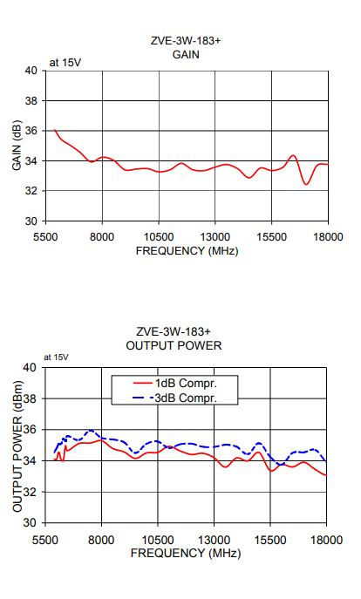
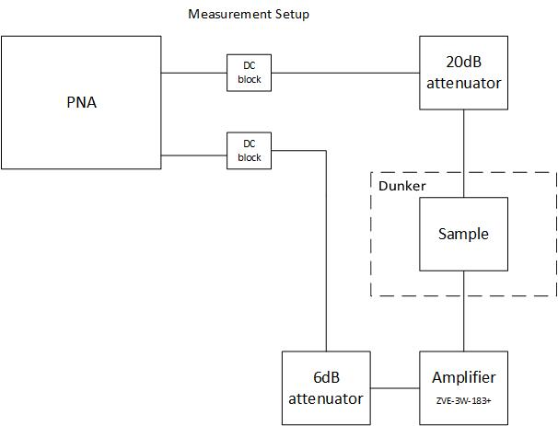
Measurement Chain
BW: 100Hz
Data Points: 5000
Output power(PNA): 0dBm
*Felix B said he used 0dBm for output power of PNA for most of his dunker testing. He has been using 0dBm because Xiao used 0dBm. However, they typically used 30dB attenuation, as opposed to 20dB attenuation.

Slide 11
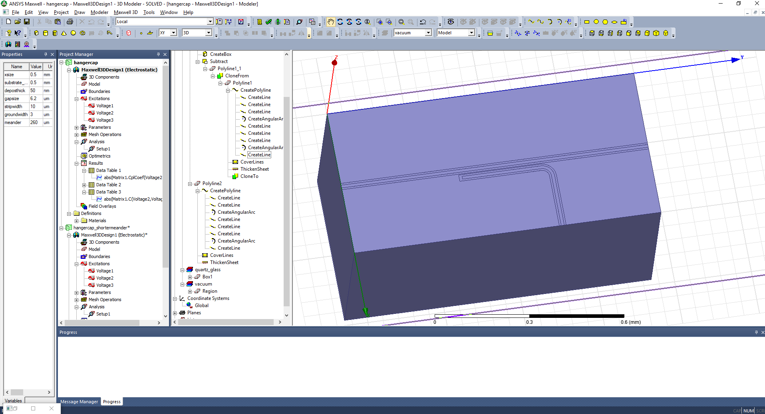
Simulating C (capacitive coupling) via Maxwell
capacitive junction defined as shown on the left and simulated.
 | C
Low Q | 2.1074e-15fF
High Q | 5.3687e-16fF
*the dielectric constant of Quartz wafer was taken into account (in Maxwell, it’s set to 3.78)

Slide 12
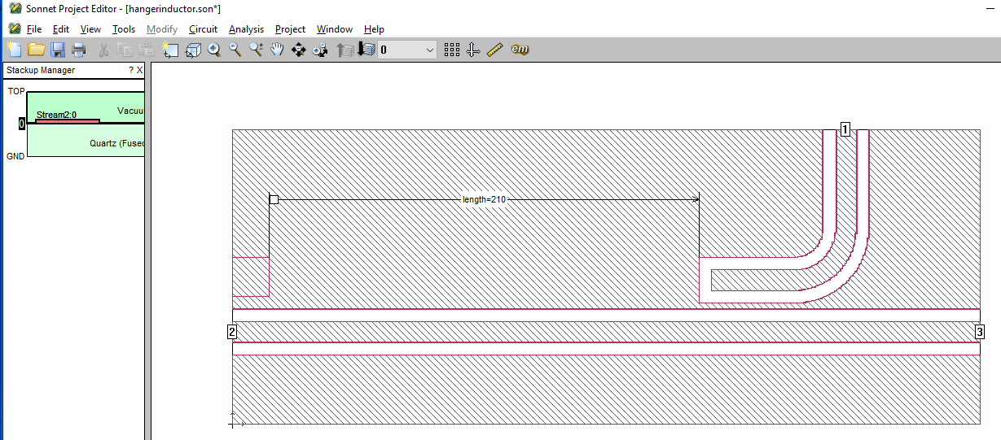
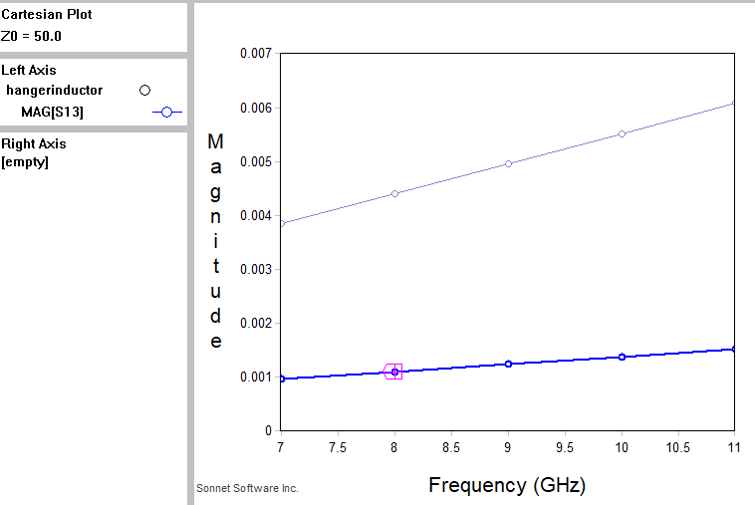
Simulating C (capacitive coupling) via Sonnet
Low Q resonator
High Q resonator
S parameter calculation via ABCD matrix for the capacitive junction used to extract C from Sonnet
 | C
Low Q | 1.28e-15fF
High Q | 3.8e-16fF
*the dielectric constant of Quartz wafer was taken into account (in Maxwell, it’s set to 3.75)

Slide 13
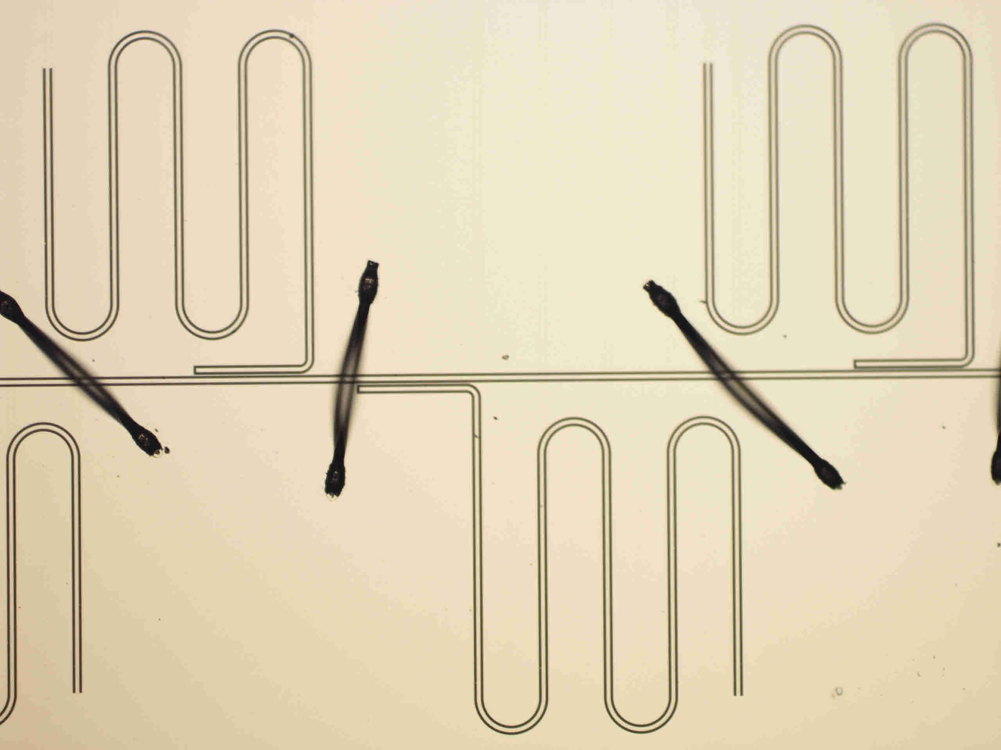
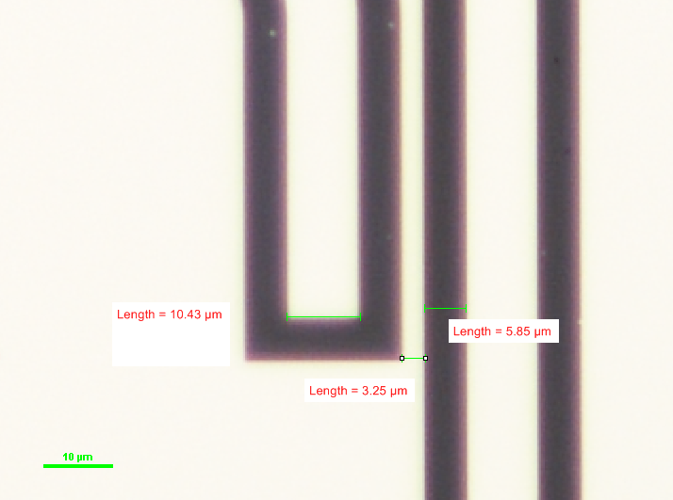
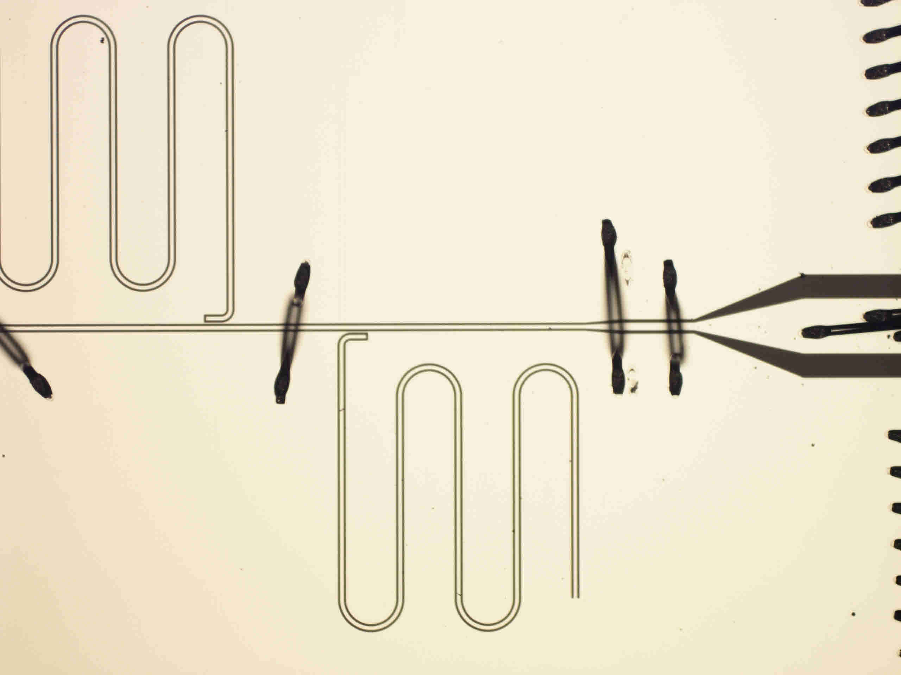
Images of Resonators
High Q resonator
Designed to be 10, 3, and 6.2um respectively (from left to right)

Slide 14
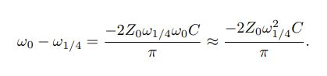
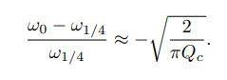
Designed frequency and Q from analytical formulas (Mazin thesis)
Eq 2.38 from pg28 of Mazin thesis
Eq 2.39 from pg29 of Mazin thesis
ω1/4 the resonance when the quarter wave condition is met.
ω0 is the “loaded frequency” taking into account frequency shift due to capacitive coupling.
Solving for Qc from equation 2.39 to obtain coupling Quality factor.
Loaded frequency ω0 is used for designed frequencies.

Slide 15
Calculated Designed frequency and Q from analytical formulas (Mazin thesis)
Loaded low Q frequency | Designed frequency (GHz) | Loaded High Q frequency | Designed frequency(GHz)
1 | 10.4952 | 1 | 11.0853
2 | 10.7884 | 2 | 11.3267
3 | 11.0086 | 3 | 11.4095
4 | 11.0136 | 4 | 11.6682
5 | 11.0691 | 5 | 11.7333
6 | 11.3442 | 6 | 12.0519
Low Q chip | Designed Q | High Q chip | Designed Q
1 | 11,686 | 1 | 163,171
2 | 11,055 | 2 | 156,277
3 | 10,614 | 3 | 154,012
4 | 10,604 | 4 | 147,246
5 | 10,498 | 5 | 145,613
6 | 9,991 | 6 | 138,001

Slide 16
Frequency Comparison Between Analytical(Mazin) and ABCD
Loaded low Q frequency (Mazin) | Designed frequency (GHz) | low Q frequency (ABCD) | Designed frequency(GHz)
1 | 10.4952 | 1 | 10.49
2 | 10.7884 | 2 | 10.79
3 | 11.0086 | 3 | 11.00
4 | 11.0136 | 4 | 11.01
5 | 11.0691 | 5 | 11.07
6 | 11.3442 | 6 | 11.34
Loaded High Q frequency (Mazin) | Designed frequency (GHz) | Loaded High Q (ABCD) | Designed frequency(GHz)
1 | 11.0853 | 1 | 11.09
2 | 11.3267 | 2 | 11.33
3 | 11.4095 | 3 | 11.41
4 | 11.6682 | 4 | 11.67
5 | 11.7333 | 5 | 11.73
6 | 12.0519 | 6 | 12.05
*good to see that analytical solutions and ABCD agree in designed frequencies

Slide 17
Q Comparison Between Analytical(Mazin) and ABCD
Loaded low Q (Mazin) | Designed Q | low Q (ABCD) | Designed Q
1 | 11,686 | 1 | 11,597
2 | 11,055 | 2 | 10,972
3 | 10,614 | 3 | 10,447
4 | 10,604 | 4 | 10,630
5 | 10,498 | 5 | 10,442
6 | 999,1 | 6 | 9,944
Loaded High Q (Mazin) | Designed Q | High Q (ABCD) | Designed Q
1 | 163,171 | 1 | 160,374
2 | 156,277 | 2 | 153,578
3 | 154,012 | 3 | 151,316
4 | 147,246 | 4 | 145,123
5 | 145,613 | 5 | 143,015
6 | 138,001 | 6 | 135,657
*good to see that analytical solutions and ABCD results come close in designed Qs

Slide 18
Designed (analytical formulas) and Measured Resonances (low Q chip 1)
Low Q chip 1 | Designed f(GHz) | Measured f(GHz) | Designed Q | Measured Q
1 | 10.4952 | 9.244 | 11,686 | 4,920
2 | 10.7884 | 9.531 | 11,055 | 3,587
3 | 11.0086 | 9.744 | 10,614 | 4,670
4 | 11.0136 | 9.766 | 10,604 | 3,984
5 | 11.0691 | 9.807 | 10,498 | 4,050
6 | 11.3442 | 10.082 | 999,1 | 5,574
*low Q chip 1 and chip2 have the same design
*designed f and Q based on C from analytical formulas(Mazin).
*Caltech Mazin thesis gives formula for approximated designed f, which gives
results close to designed f from ABCD matrix method

Slide 19
Designed (analytical formulas) and Measured Resonances (low Q chip 2)
Low Q chip 2 | Designed f(GHz) | Measured f(GHz) | Designed Q | Measured Q
1 | 10.4952 | 9.285 | 11,686 | 4,843
2 | 10.7884 | absent | 11,055 | absent
3 | 11.0086 | 9.771 | 10,614 | 3,242
4 | 11.0136 | 9.783 | 10,604 | 3,748
5 | 11.0691 | 9.799 | 10,498 | 4,168
6 | 11.3442 | 10.091 | 999,1 | 4,538
*low Q chip 1 and chip2 have the same design
*designed f and Q based on C from analytical formulas(Mazin).

Slide 20
Designed (analytical formulas) and Measured Resonances (high Q)
High Q chip | Designed f(GHz) | Measured f(GHz) | Designed Q | Measured Q
1 | 11.0853 | 9.734 | 163,171 | 21,324
2 | 11.3267 | 9.962 | 156,277 | 20,882
3 | 11.4095 | 10.043 | 154,012 | 20,514
4 | 11.6682 | 10.281 | 147,246 | 29,603
5 | 11.7333 | 10.342 | 145,613 | 20,644
6 | 12.0519 | 10.633 | 138,001 | 21,375
*designed f and Q based on C from Maxwell and Mazin thesis analytical formulas

Slide 21
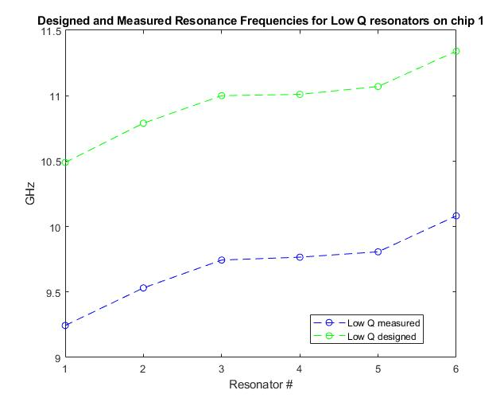
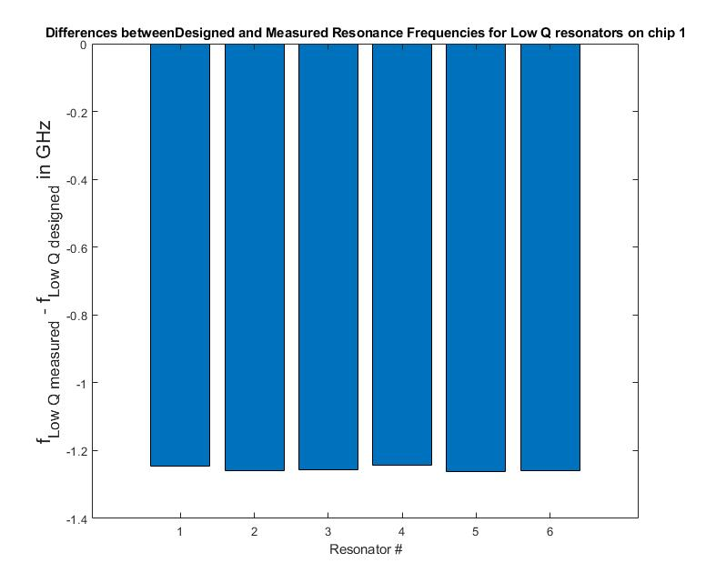
Designed and Experimental Resonance Plot for Low Q resonators chip 1 (ε_{r}=3.78 and coupler length included)

Slide 22
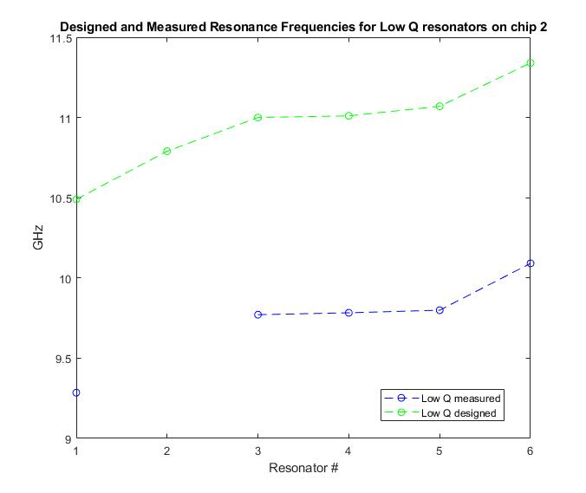
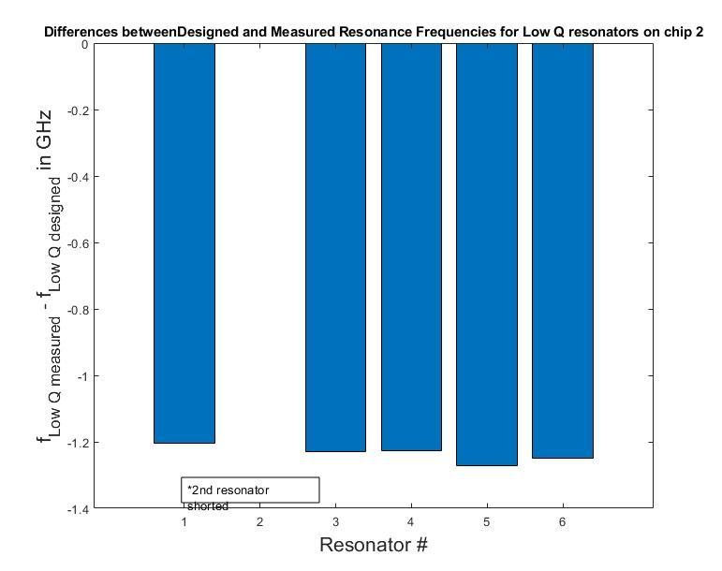
Designed and Experimental Resonance Plot for Low Q resonators chip 2 (ε_{r}=3.78 and coupler length included)

Slide 23
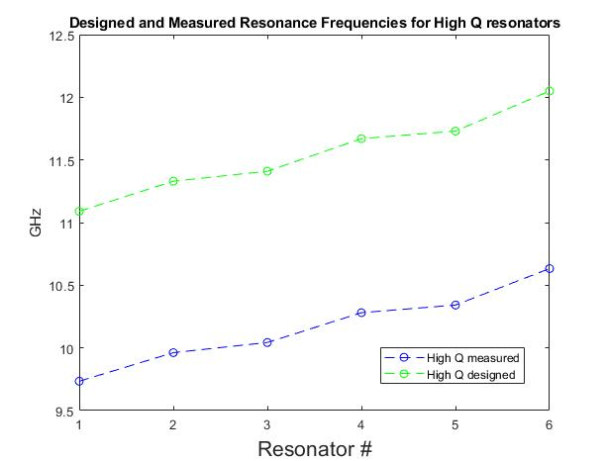
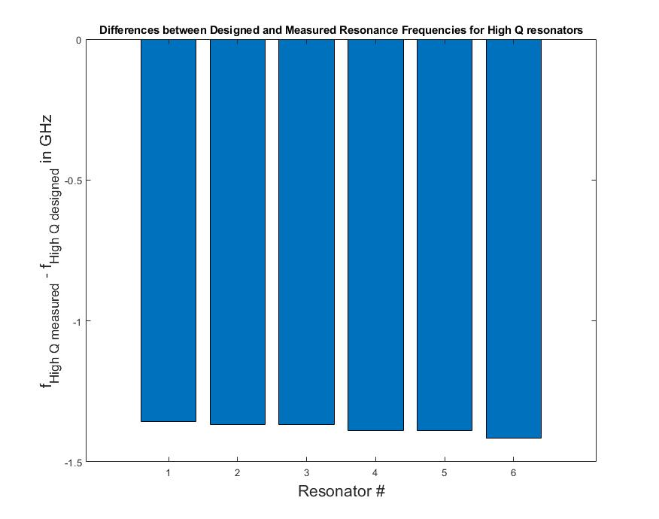
Designed and Experimental Resonance Plot for High Q resonators chip (ε_{r}=3.78 and coupler length included)

Slide 24
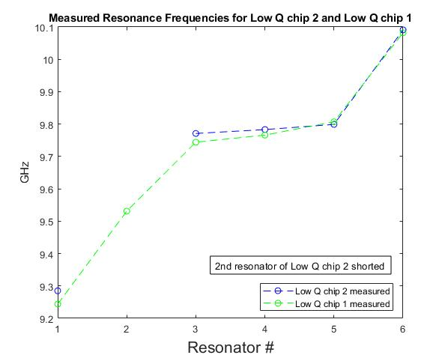
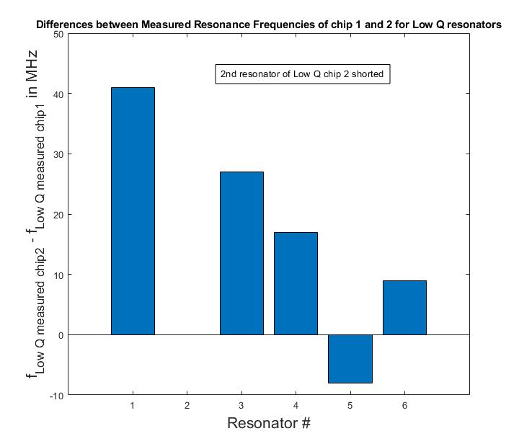
Consistency Test Between Low Q chip 1 and 2 (ε_{r}=3.78 and coupler length included)

Slide 25
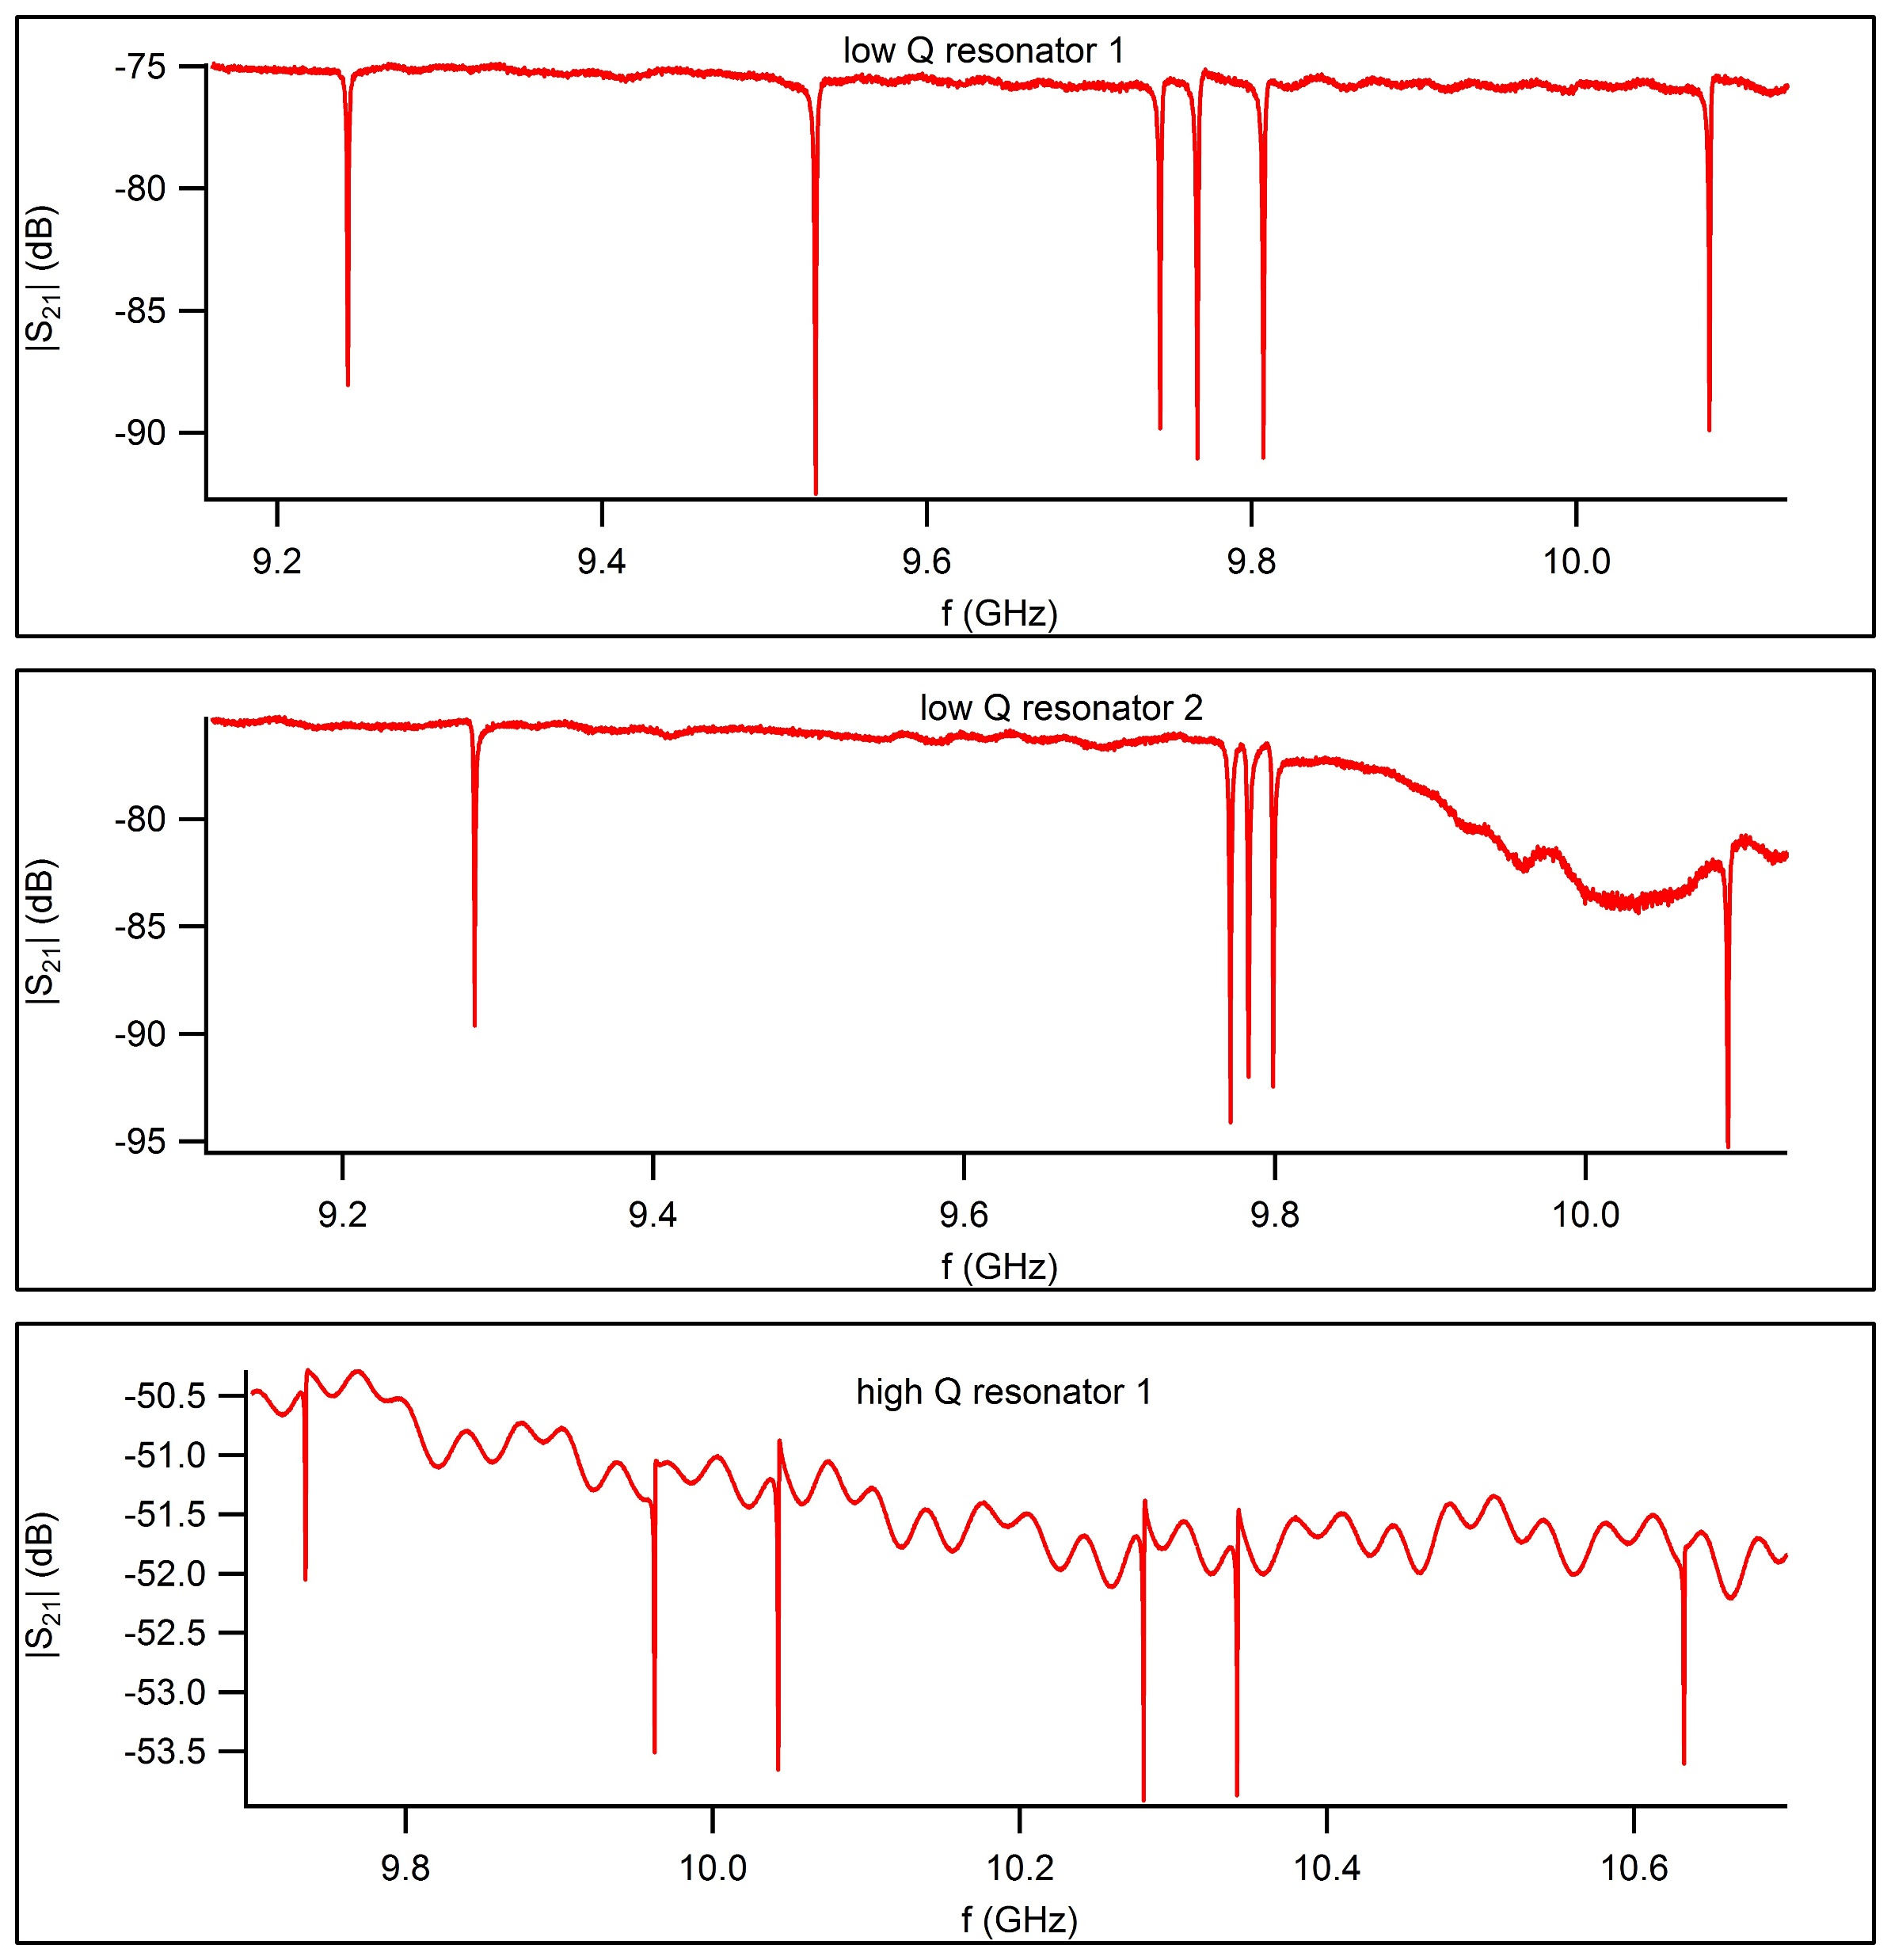
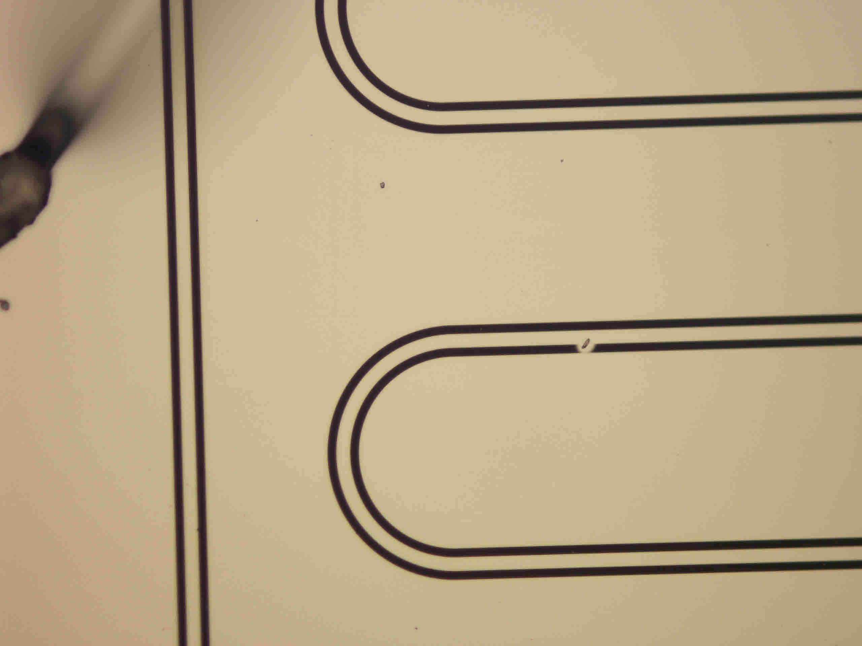
S21 spectra
9.532GHz
9.244GHZ
The missing resonance in the low Q resonator chip 2 spectrum attributed to the shorting in the fab (image above)
Low Q resonator chip 1 and Low Q resonator chip 2 are identical in design
9.285GHZ

Slide 26
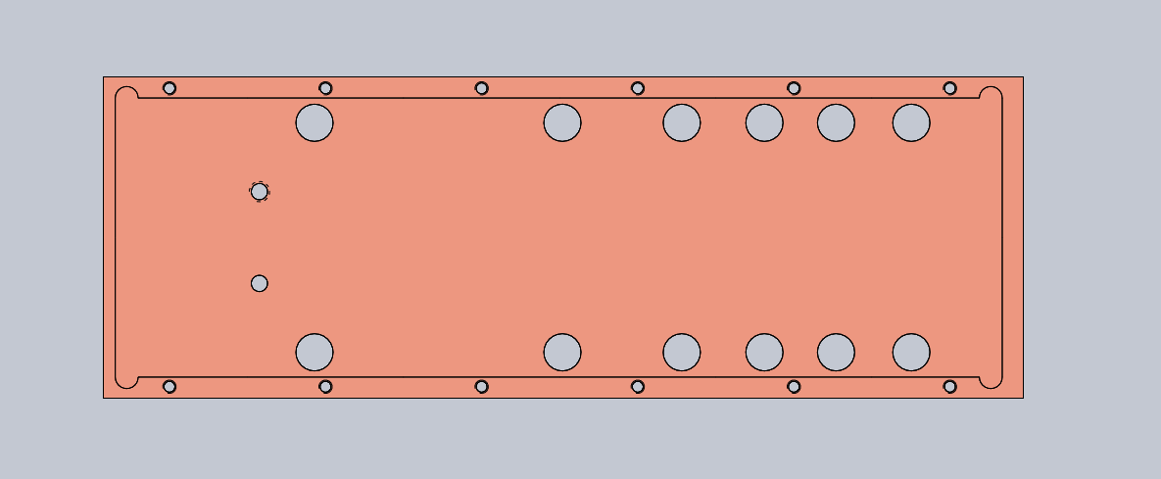
Why high Q baseline transmission is about 25dB higher ?
Y3
Y4
R3
R4
B3
B4
Input
Low Q 2
High Q
Low Q 1
Output
Y1
Y2
R1
R2
B1
B2
Front view on sample box, this means on PCB input is left, output is right.
More lossy lines, always on input side (no extra att. Of signal)
*the lossy channels account for the difference of 25dB (S21 characterization of the PCB shown in the next slide)

Slide 27
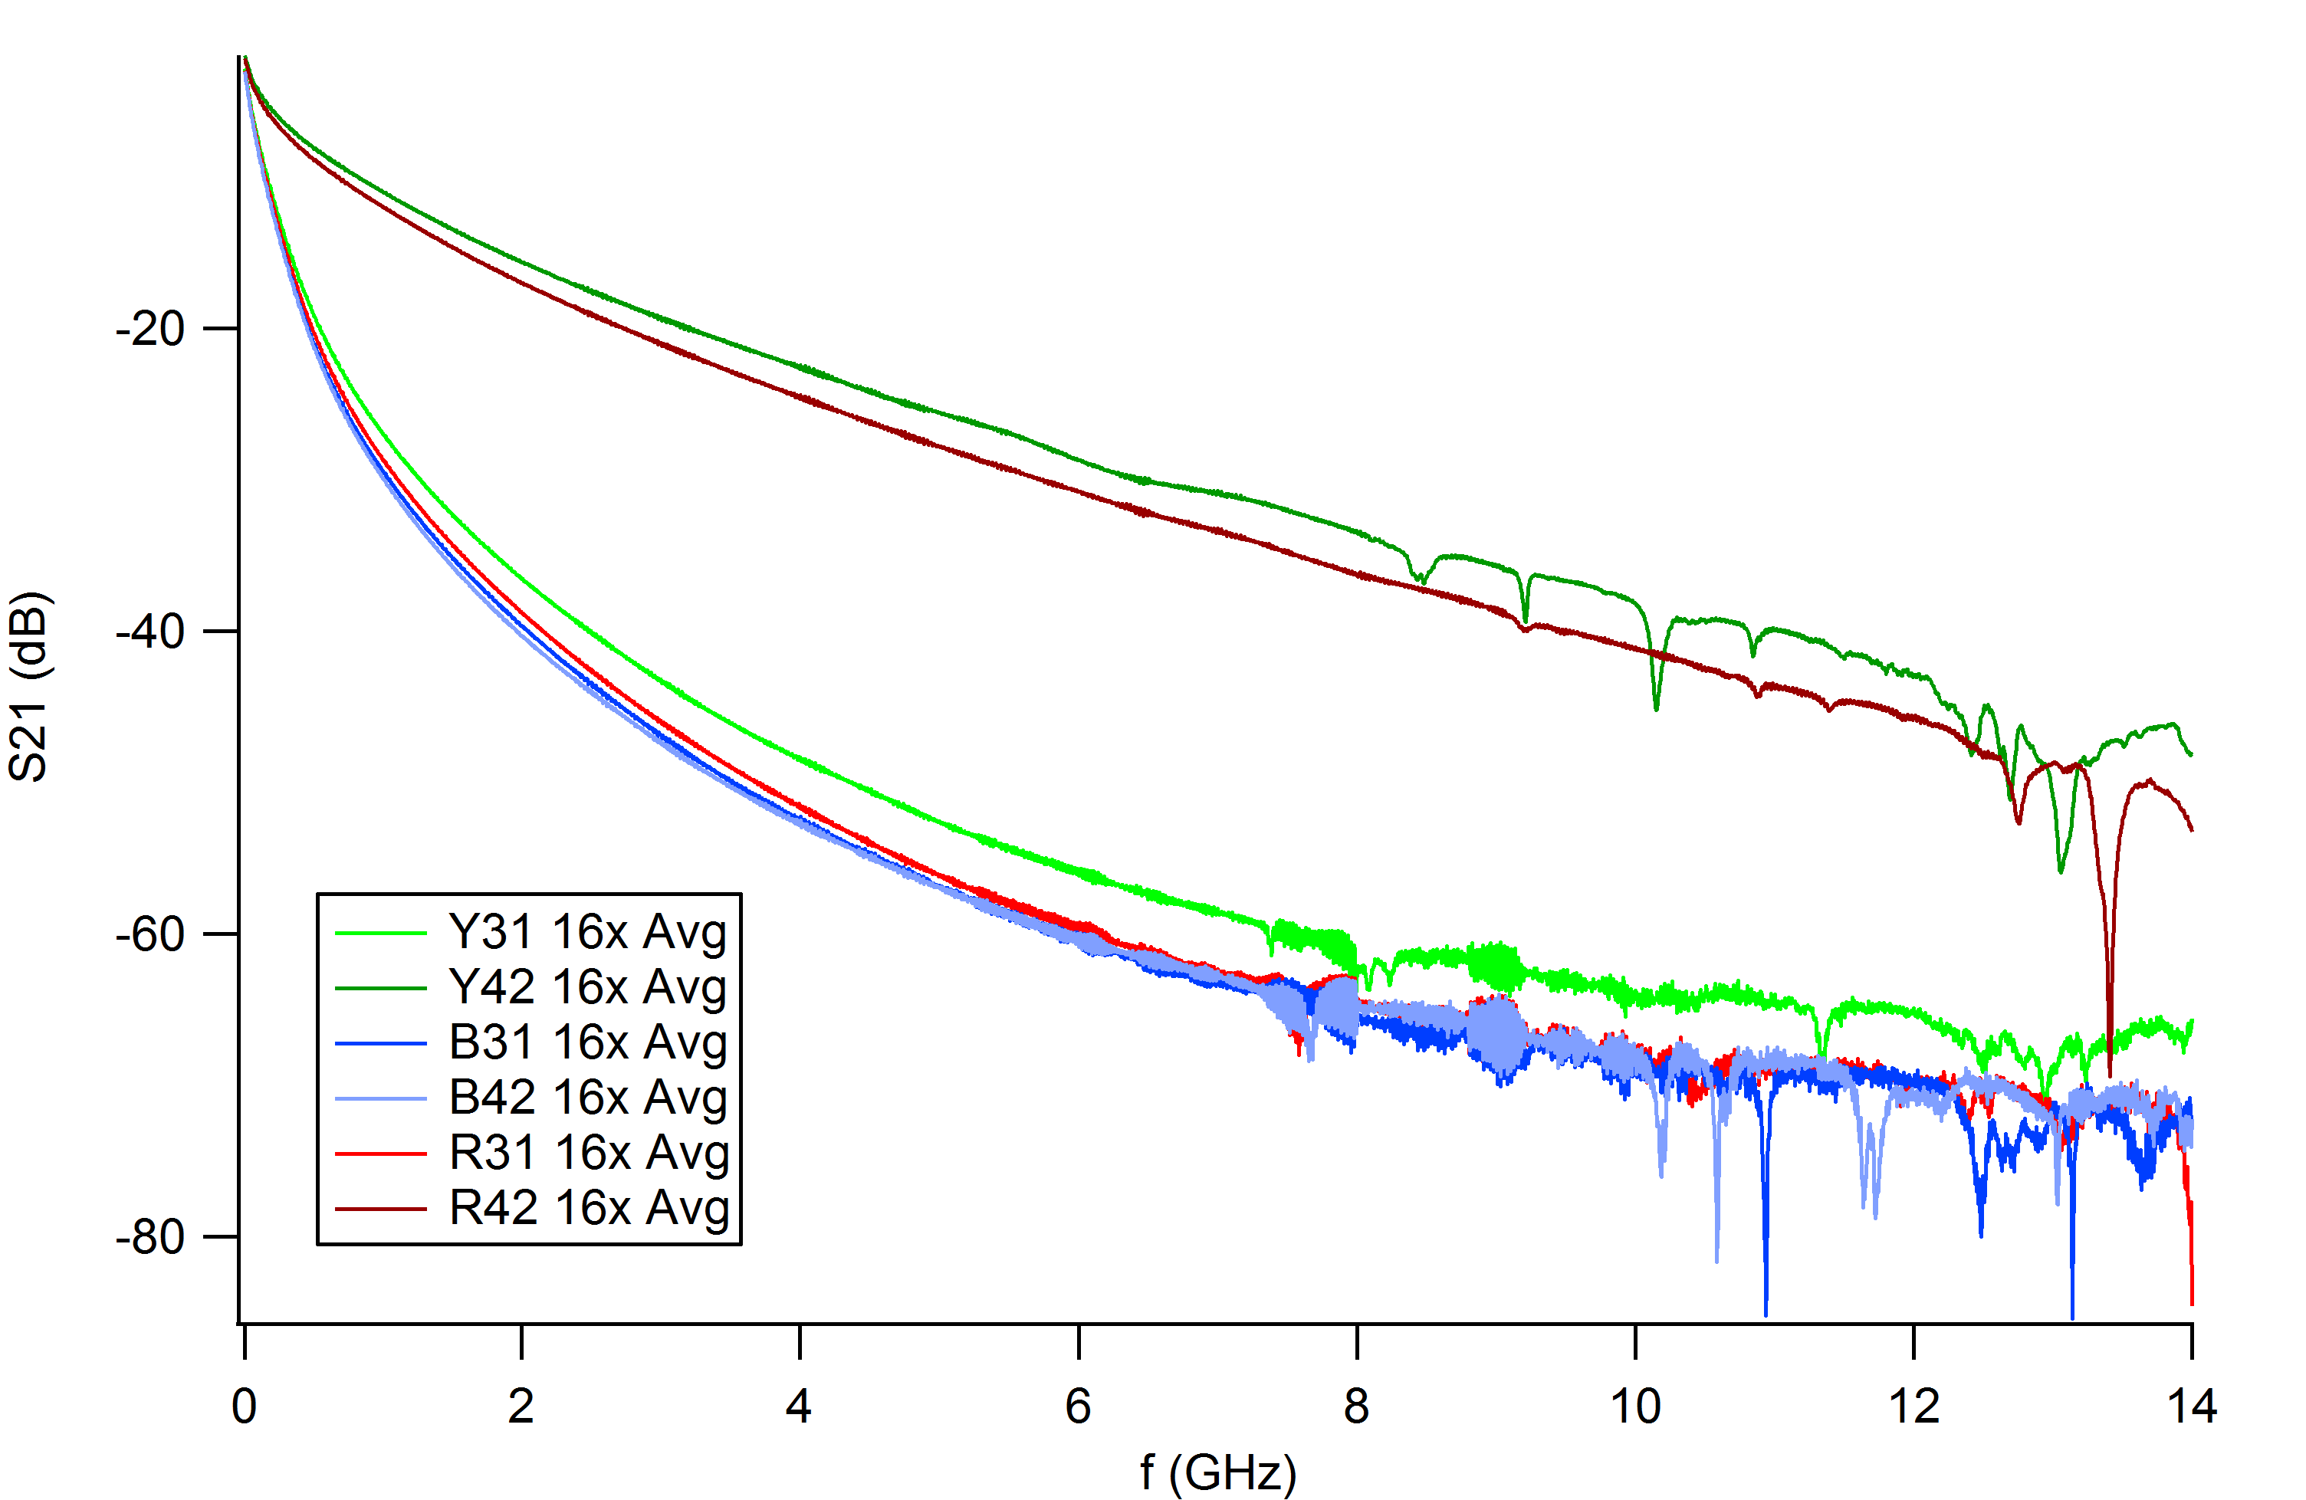
S21 measurements (From Felix B’s powerpoint)
Measurement through blue Minicircuits coax cables (background) has been subtracted

Slide 28
What happens to designed frequency if length of coupler is excluded?
High Q chip | Designed f(GHz) w/ coupler length | Designed f(GHz) w/o coupler length | Low Q chip | Designed f(GHz) w/ coupler length | Designed f(GHz) w/o coupler length
1 | 11.0853 | 11.1352 | 1 | 10.4952 | 10.9942
2 | 11.3267 | 11.4574 | 2 | 10.7884 | 11.2315
3 | 11.4095 | 11.6980 | 3 | 11.0086 | 11.3129
4 | 11.6682 | 11.7019 | 4 | 11.0136 | 11.5477
5 | 11.7333 | 11.7844 | 5 | 11.0691 | 11.6309
6 | 12.0519 | 12.1009 | 6 | 11.3442 | 11.9438
*For obvious reasons, not including coupler length places designed frequencies higher

Slide 29
Why discrepancies in high Q resonator Q values are higher?
When the dip goes down more than 6dB, overcoupled, if less, undercoupled
For High Q resonator, the dips are around 2dB
-> internal Q factor becomes dominant and designed Qc is no longer a reliable estimate.
(consistent with https://arxiv.org/pdf/1605.01996.pdf)
For Low Q resonator, the dips are about 15dB or more
-> overcoupled and total Q dominated by Qc
Also, I’ve been told by Anthony and Felix S that for dunker testing, difficult for measured Q to go above 30,000.
-15dB
-2dB

Slide 30
What dielectric constant value leads to consistent designed f and measured f ?
When ε_{r}=5.2 is assumed, greater agreement between measured and designed f.
3.7-3.8 is widely quoted for quartz dieleictric constant but some papers do quote higher value. Also, it is crystal direction dependent. (https://www.ias.ac.in/article/fulltext/seca/025/05/0408-0412).
*No dielectric constant was provided by the vendor for the z cut quartz wafer
Not much change in designed Q
Maxwell simulation for C with ε_{r}=5.2
 | C
Low Q | 2.705533fF
High Q | 0.697073fF

Slide 31
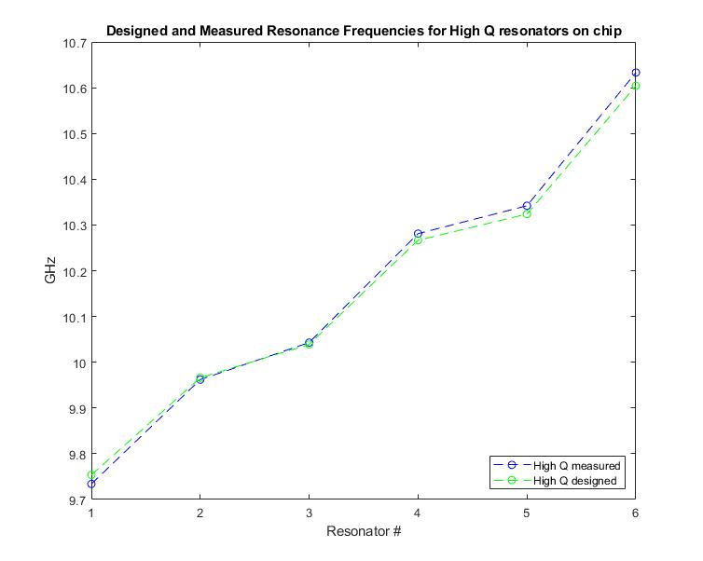
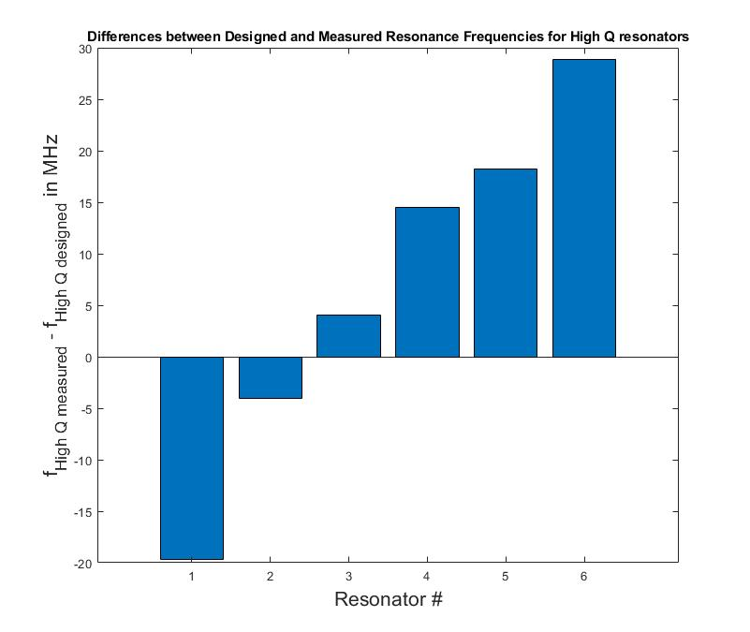
Designed and Experimental Resonance Plot for High Q resonators chips (ε_{r}=5.2 and coupler length included)

Slide 32
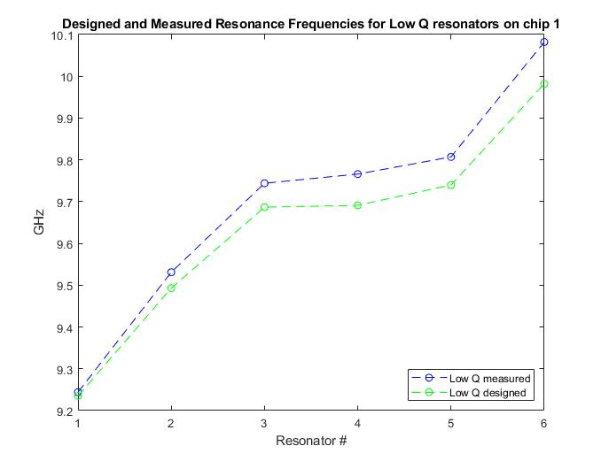
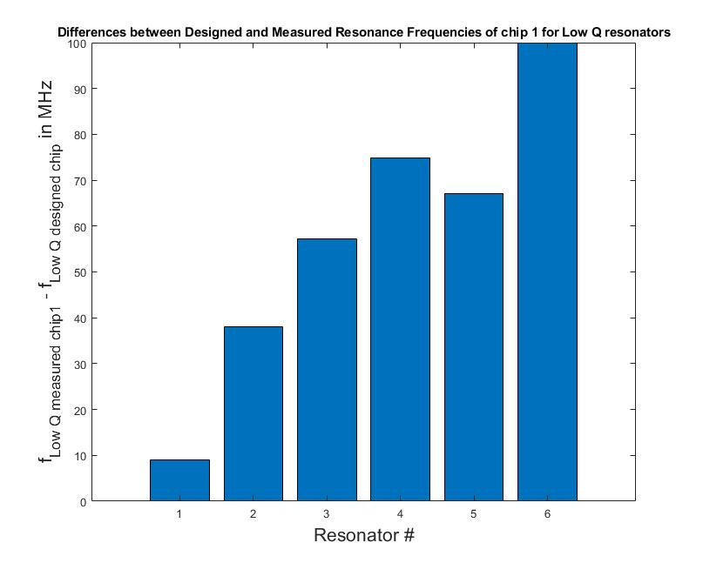
Designed and Experimental Resonance Plot for Low Q resonators chip 1 (ε_{r}=5.2 and coupler length included)

Slide 33
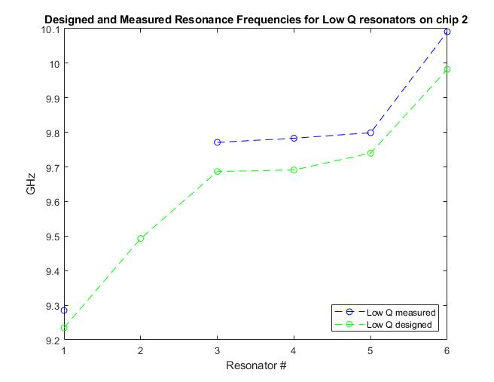
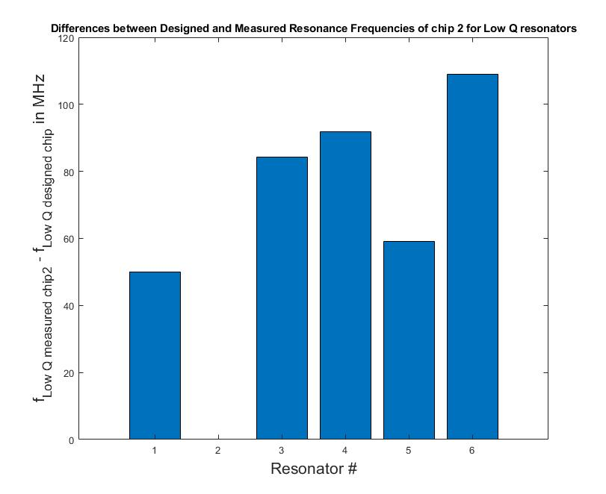
Designed and Experimental Resonance Plot for Low Q resonators chip 1 (ε_{r}=5.2 and coupler length included)

Slide 34
Comments On Designed f and Q with ε_{r}=5.2 assumed
Note designed frequencies are consistently lower than measured values for low Q chips
Since Low Q resonators have longer couplers and because lumped element model begins to lose its validity as coupler gets longer, it may make sense not to include whole length of coupler to total length of resonator. In reality, it’s somewhere between total exclusion and total inclusion of coupler length.
If entire length of coupler is taken out, measured frequencies are lower than designed frequencies. (refer to the plots in subsequent slides)

Slide 35
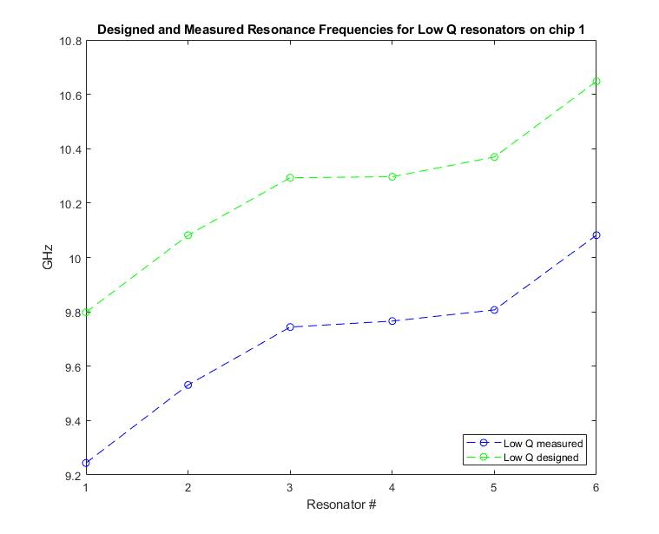
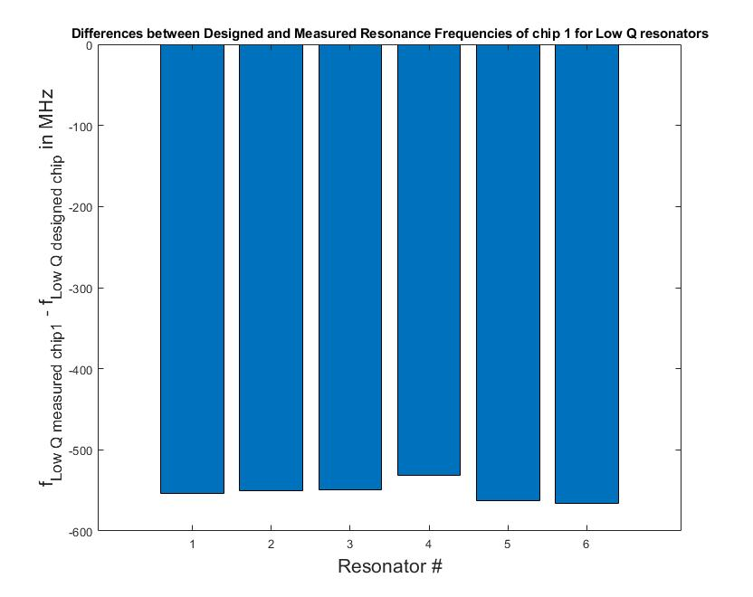
Designed and Experimental Resonance Plot for Low Q resonators chip 1 (ε_{r}=5.2 and coupler length subtracted)

Slide 36
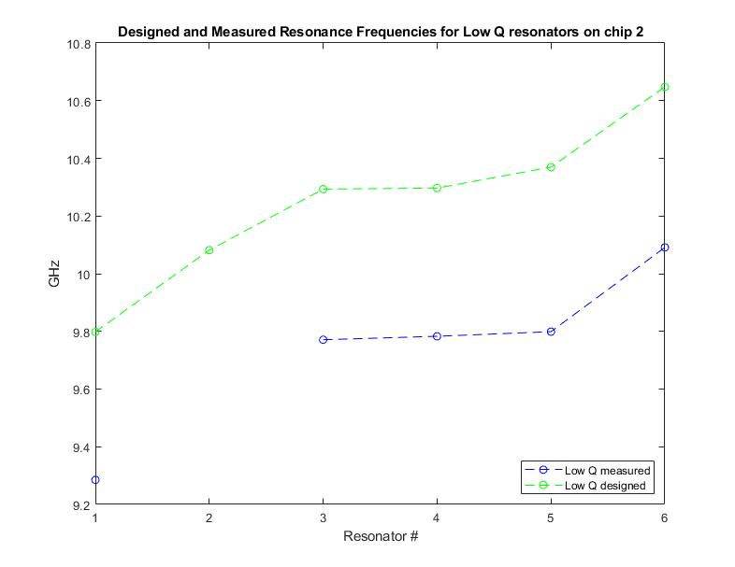
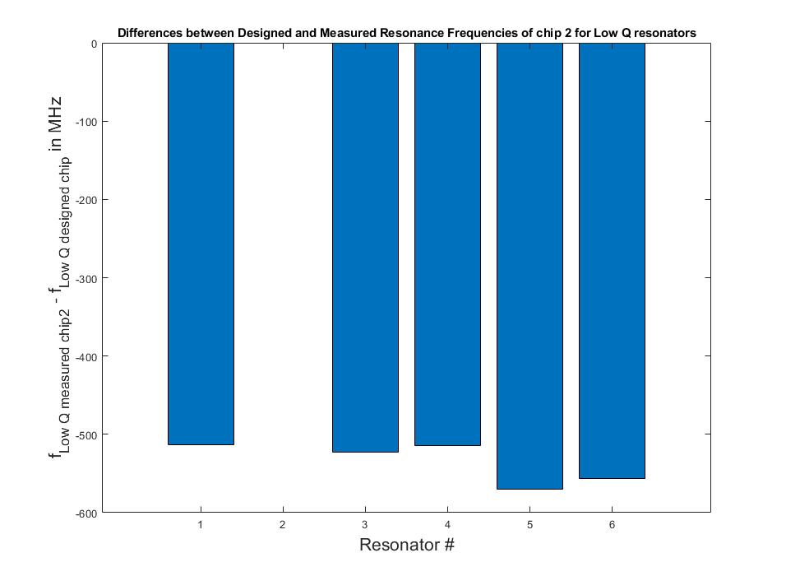
Designed and Experimental Resonance Plot for Low Q resonators chip 2 (ε_{r}=5.2 and coupler length subtracted)

Slide 37
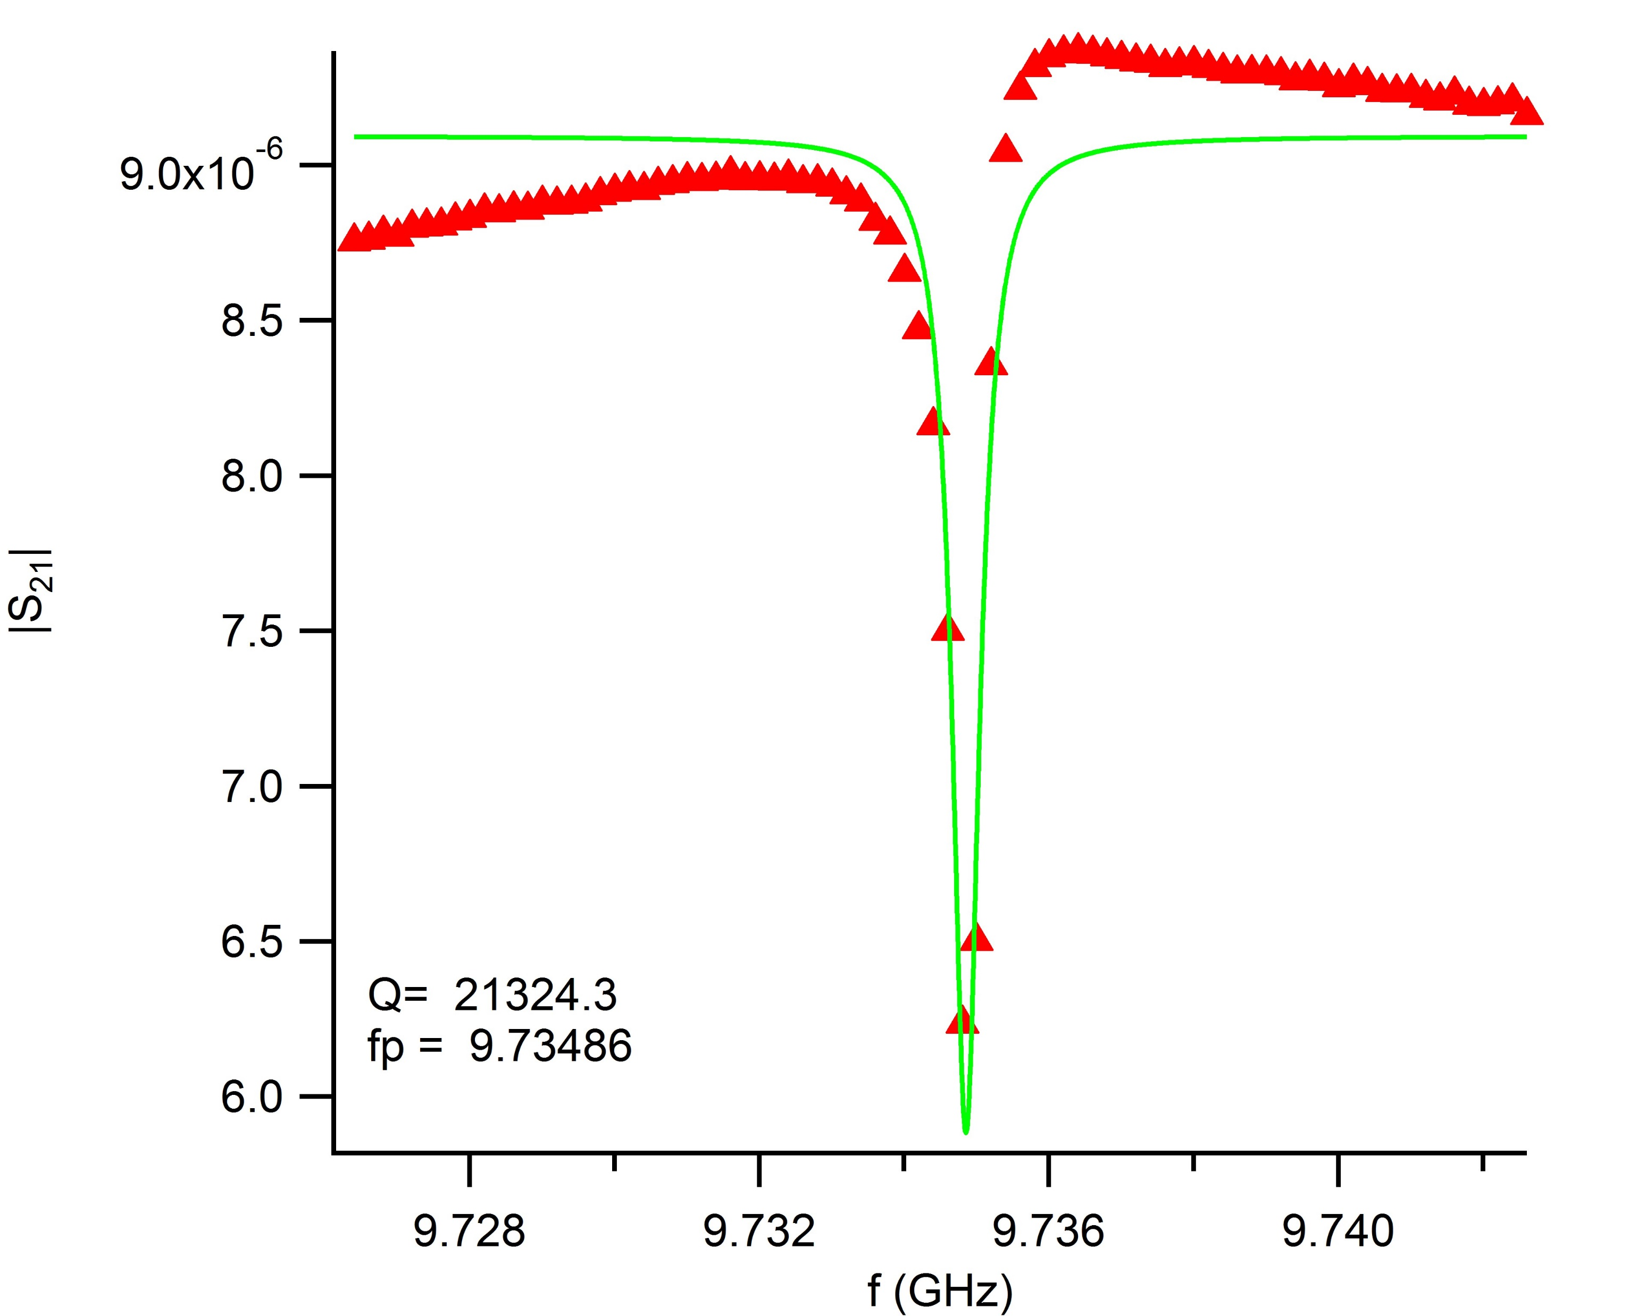
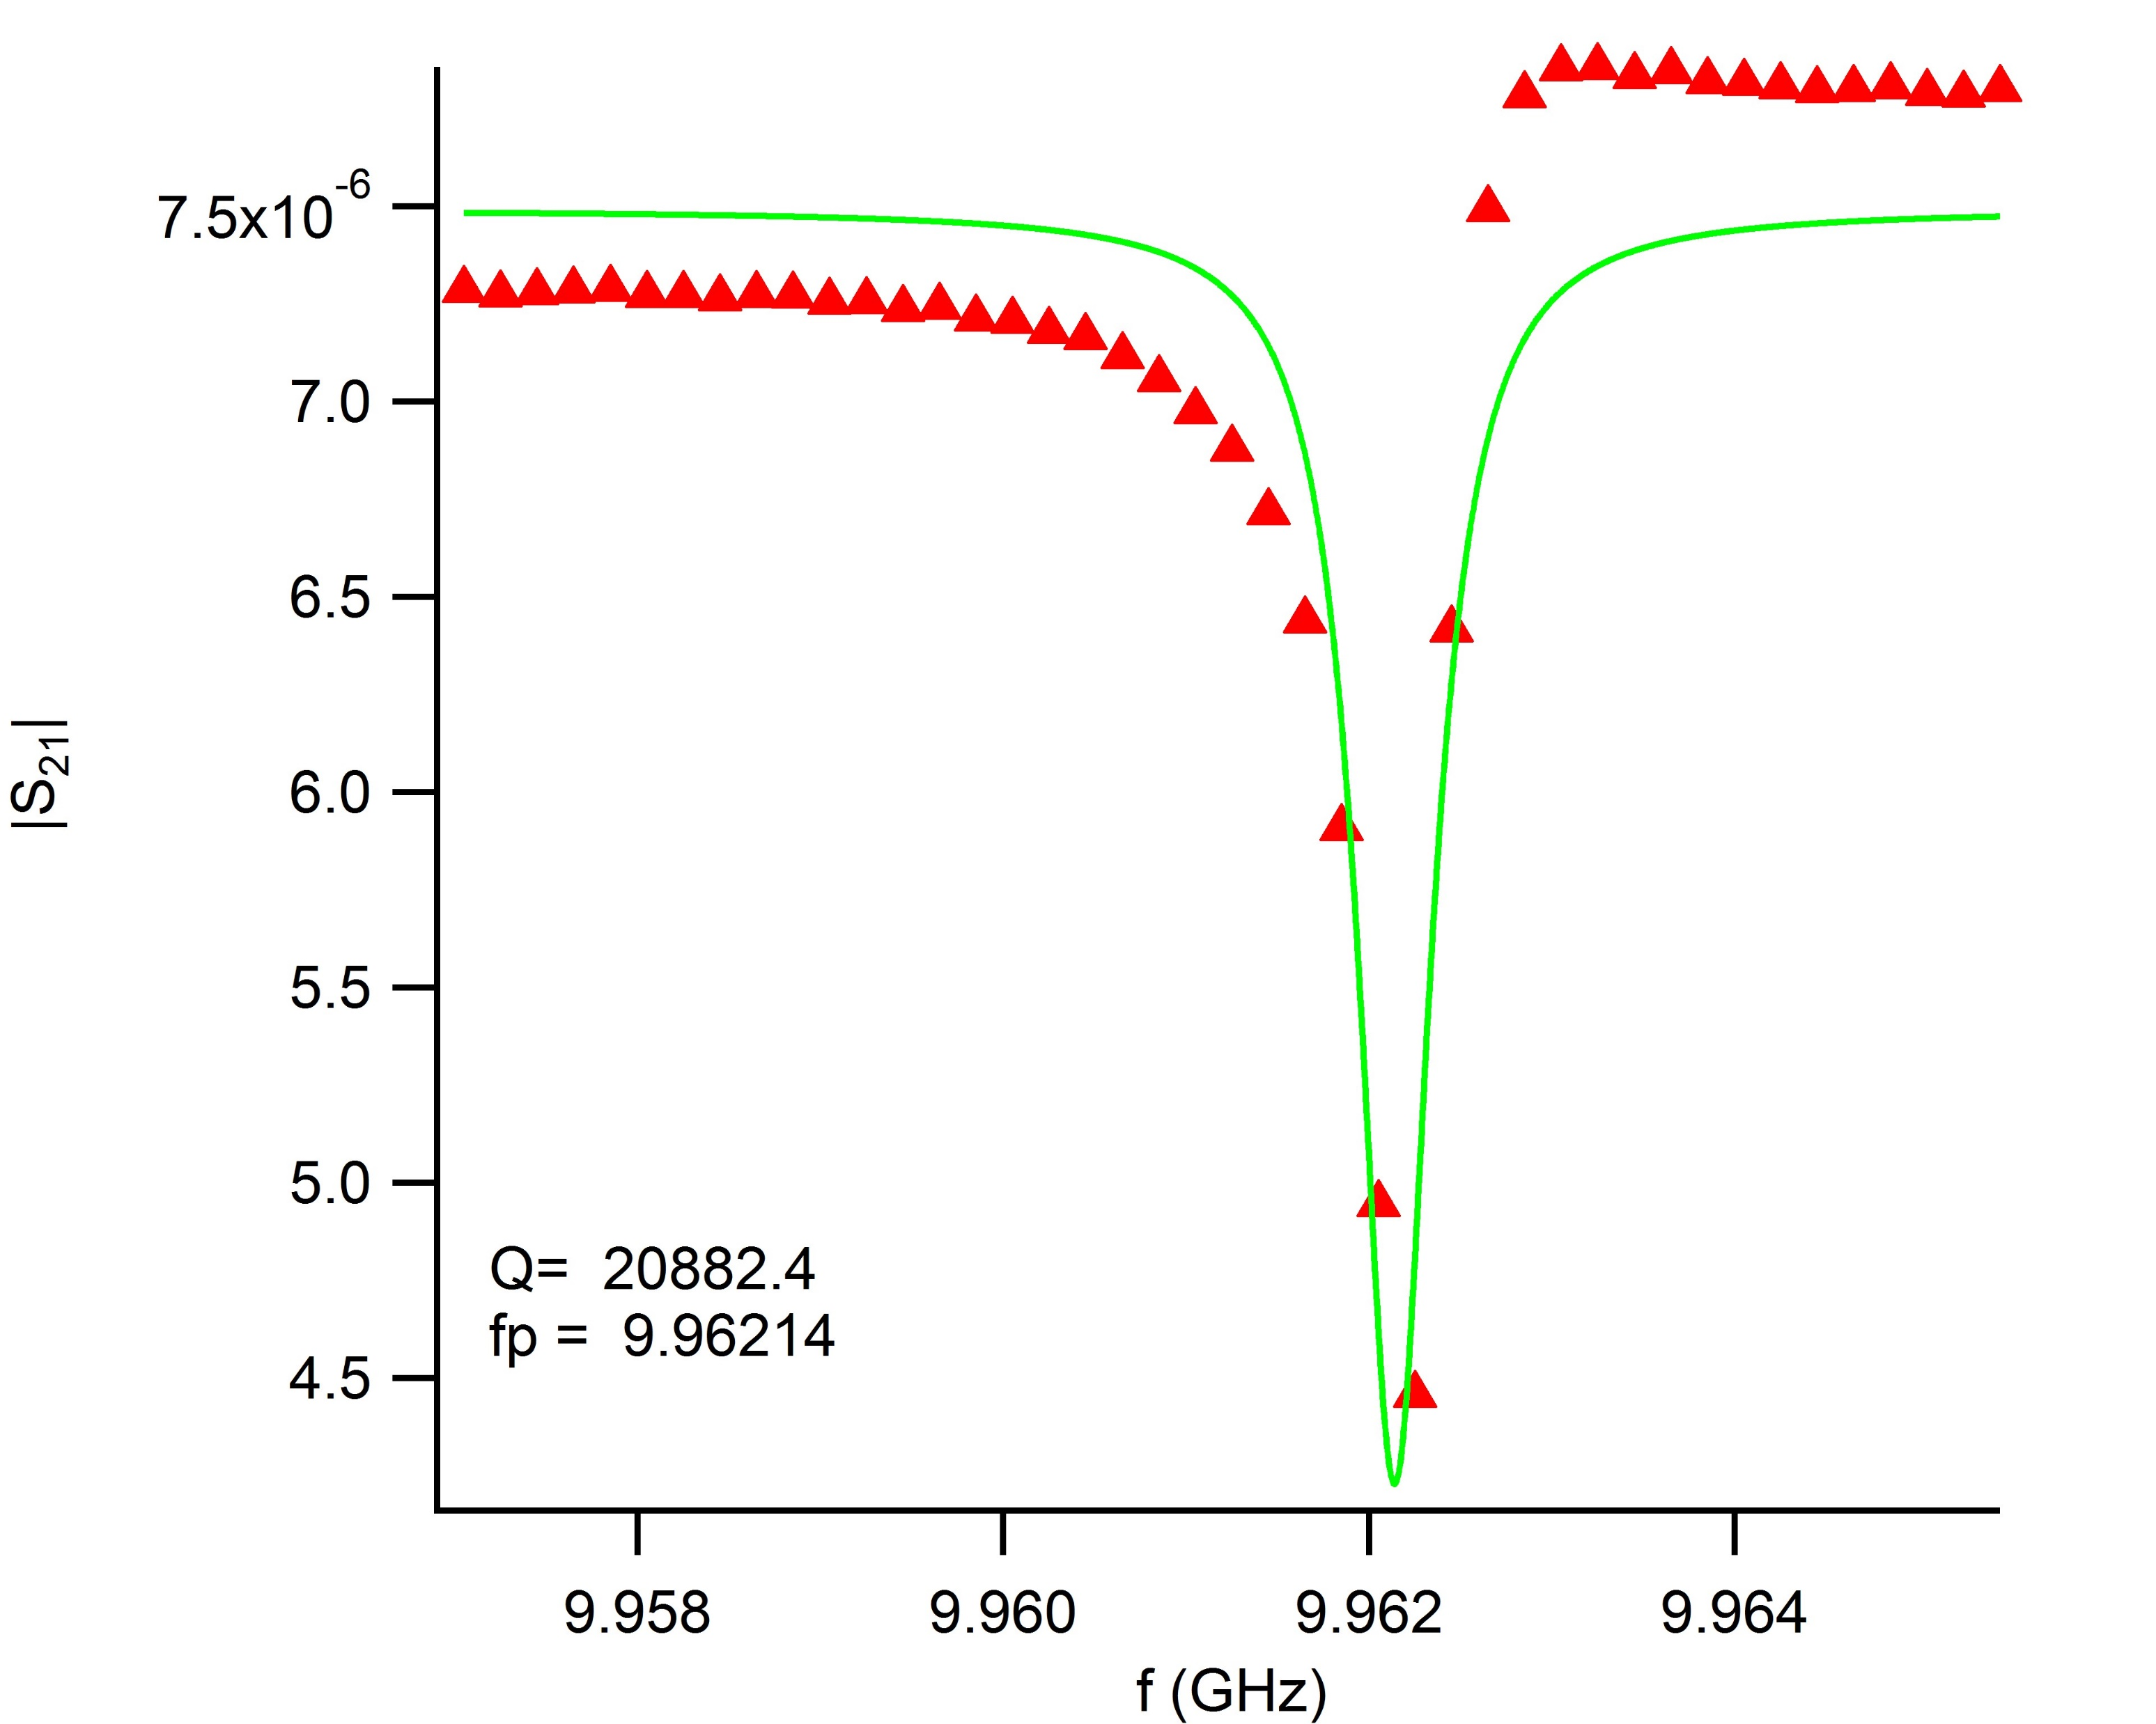
High Q Resonator Chip (resonator 1 and 2)

Slide 38
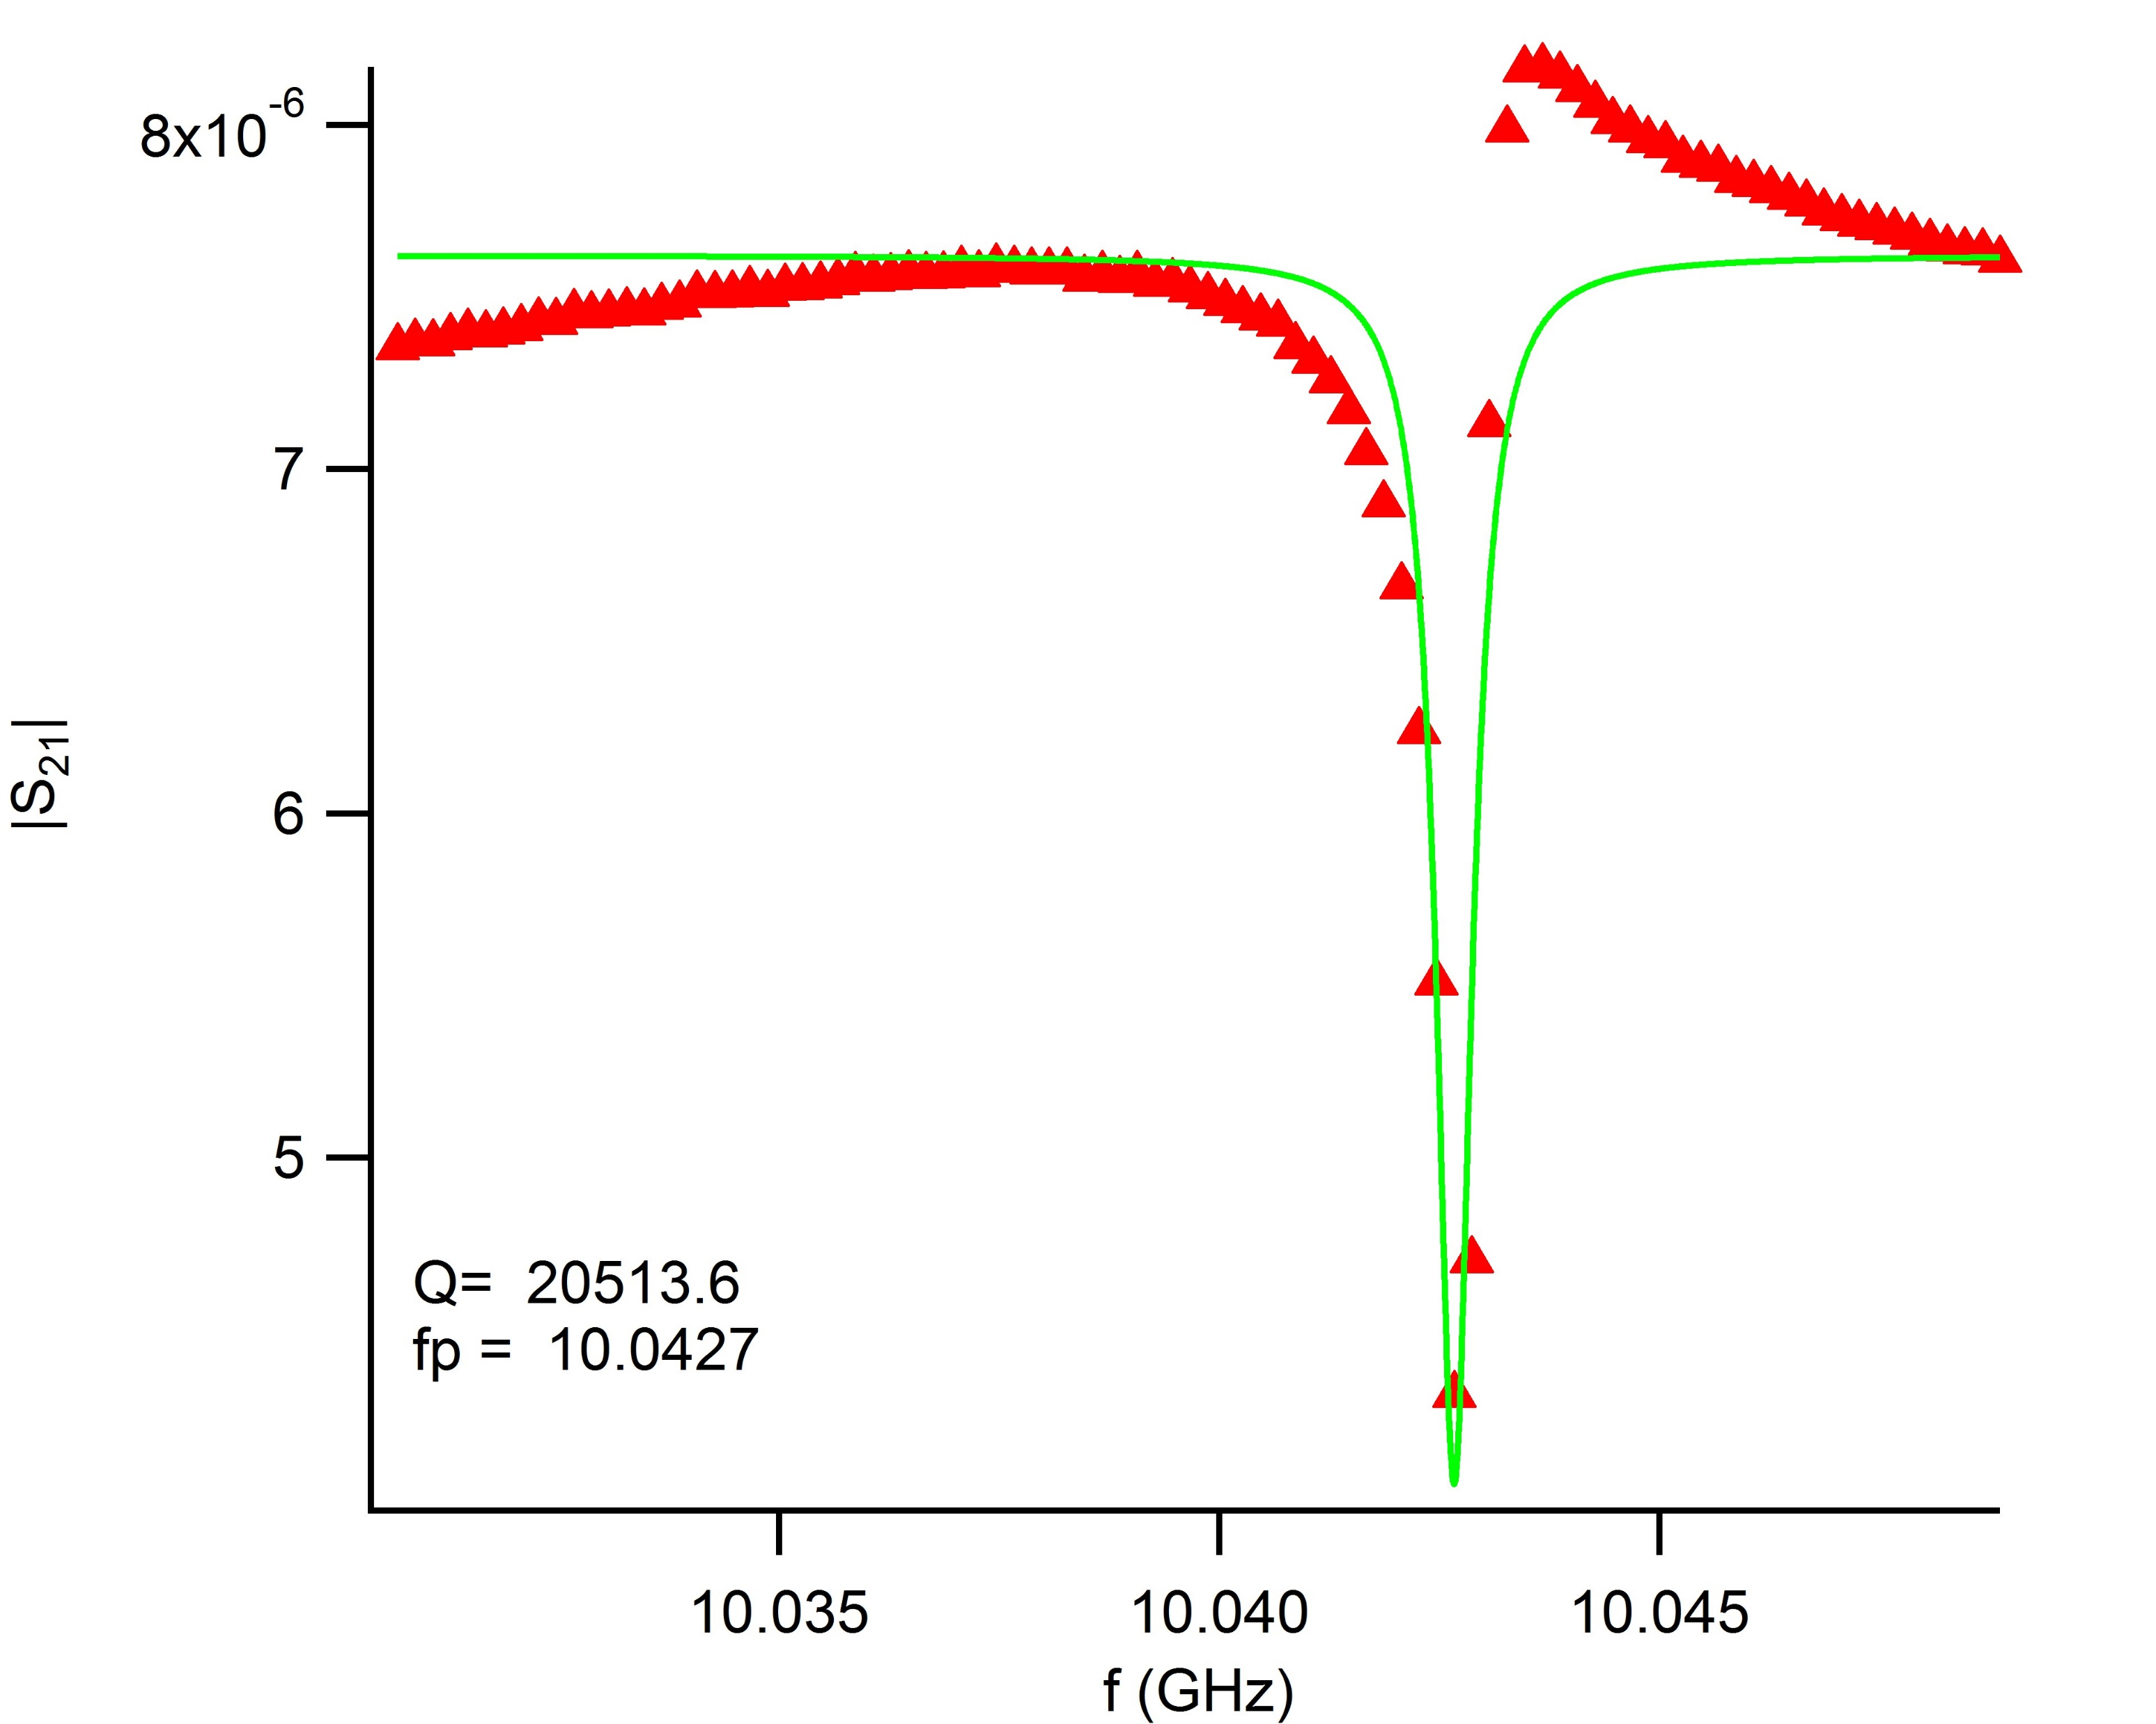
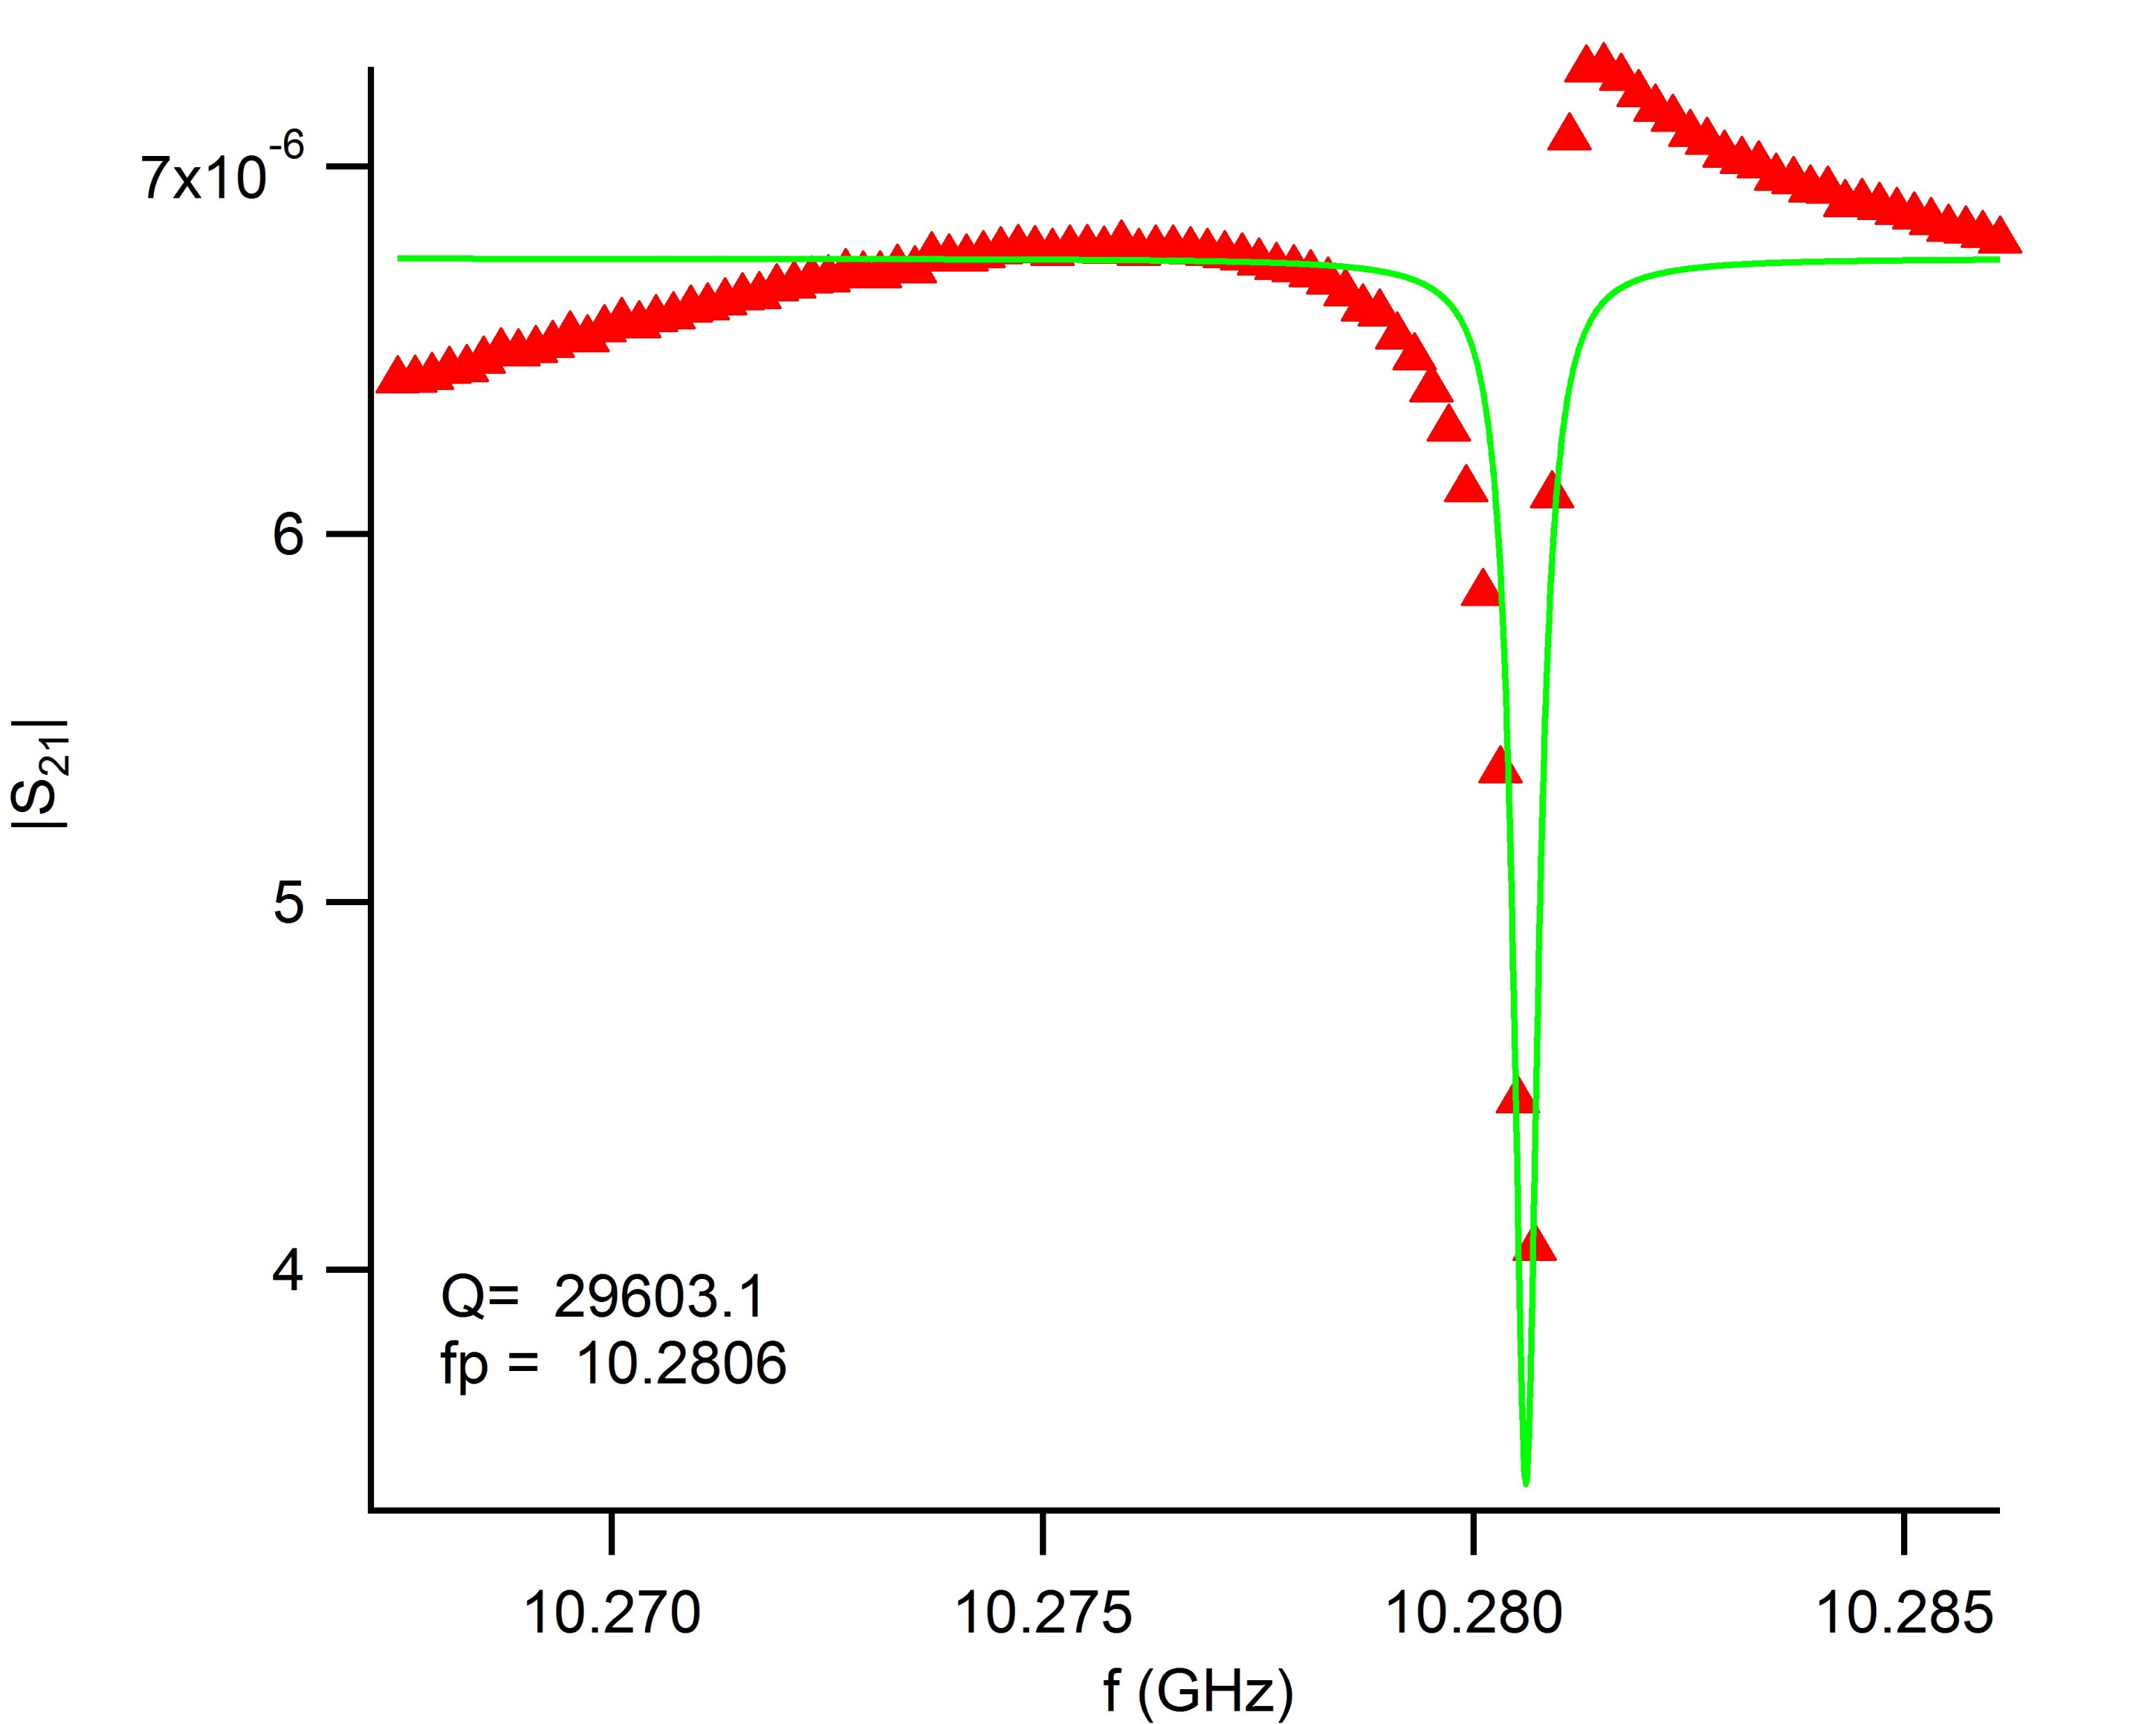
High Q Resonator Chip (resonator 3 and 4)

Slide 39
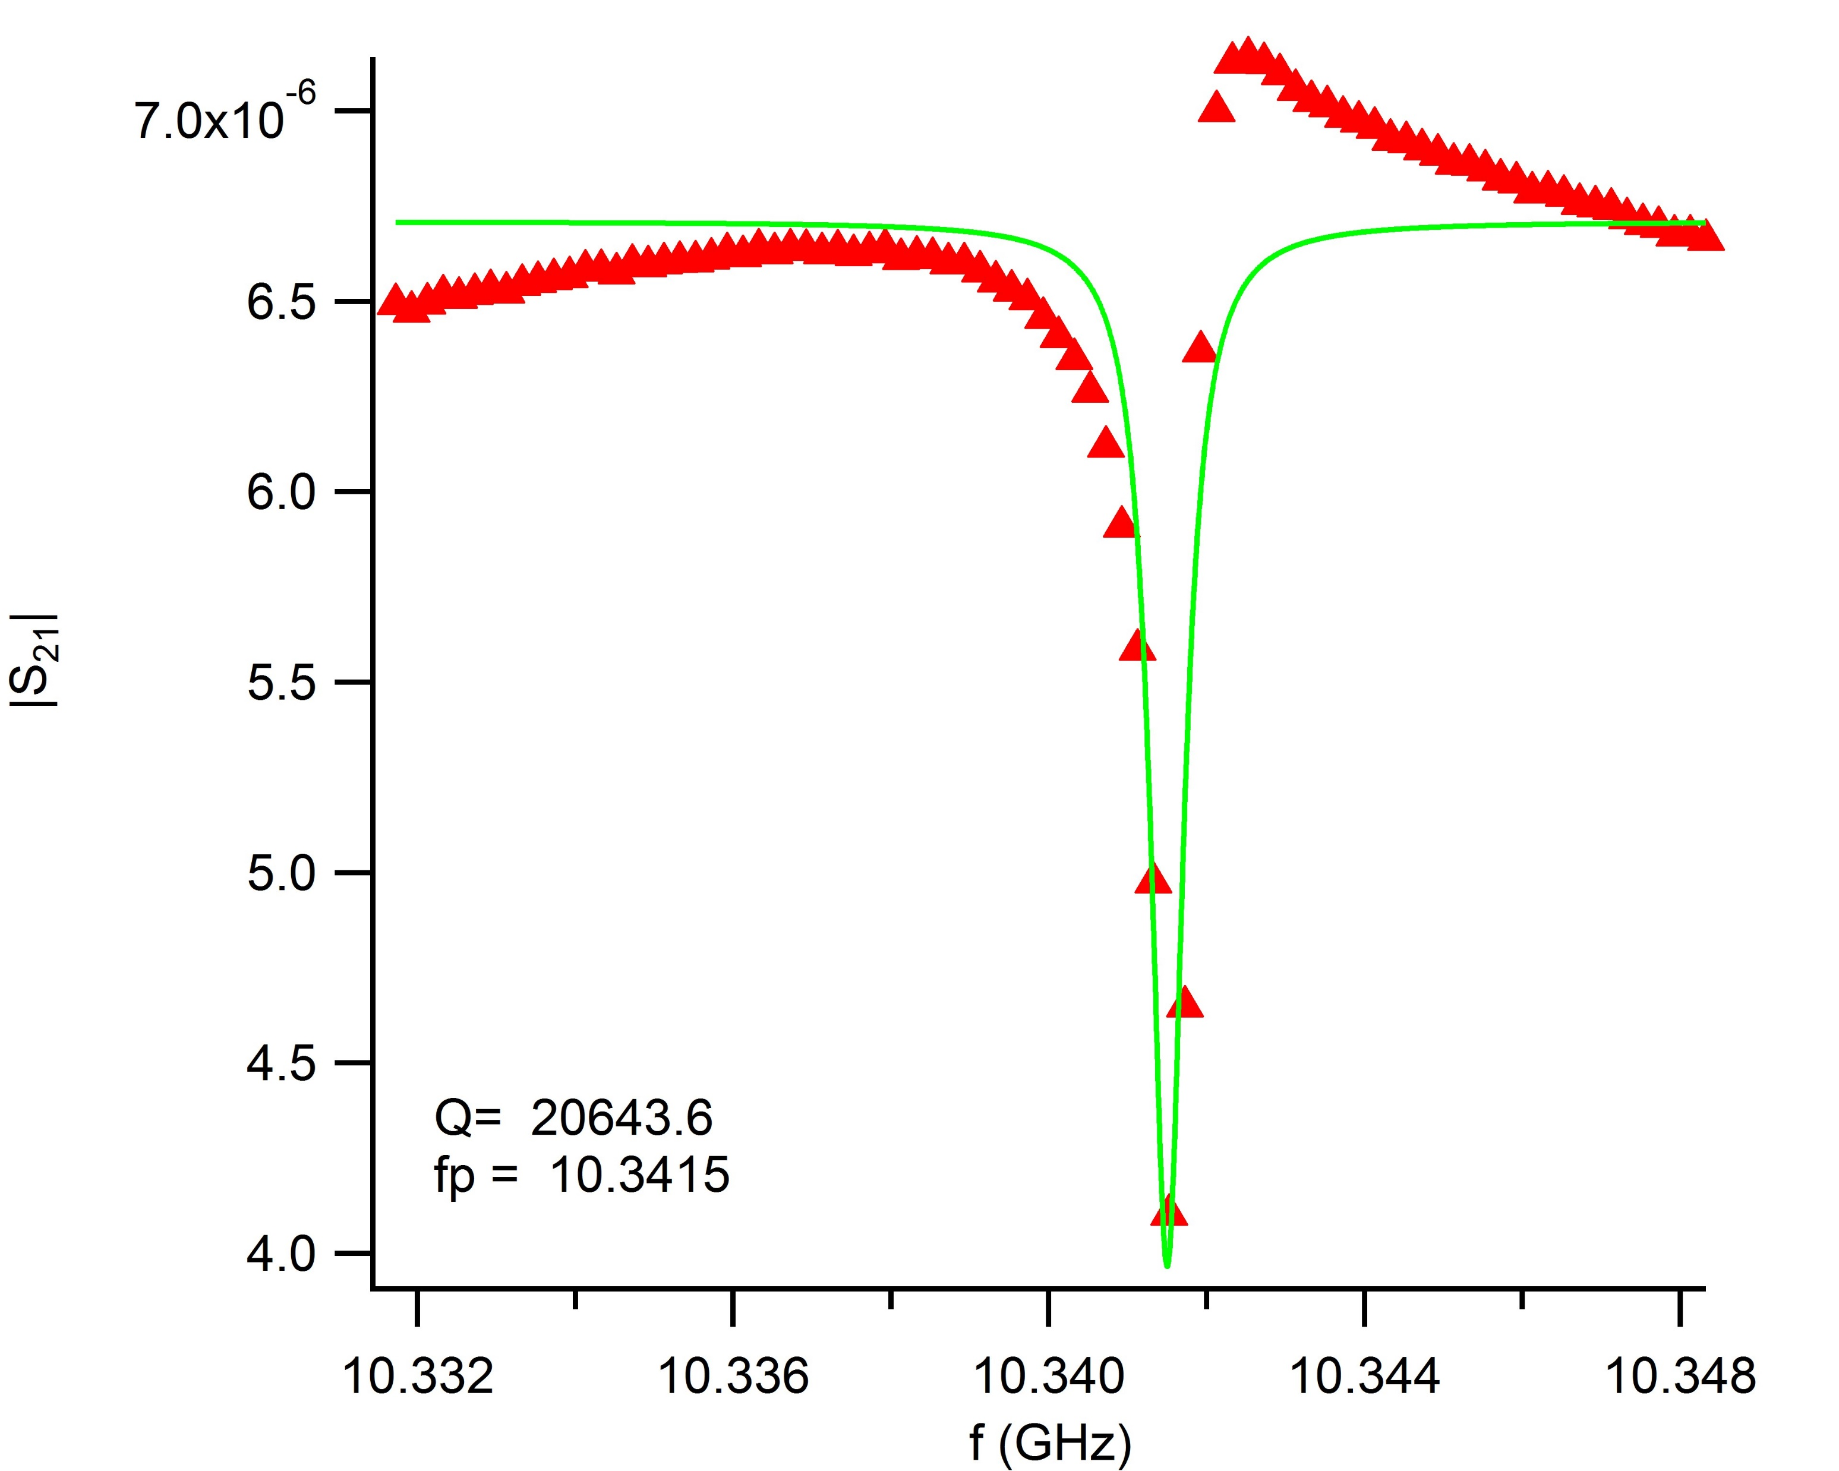
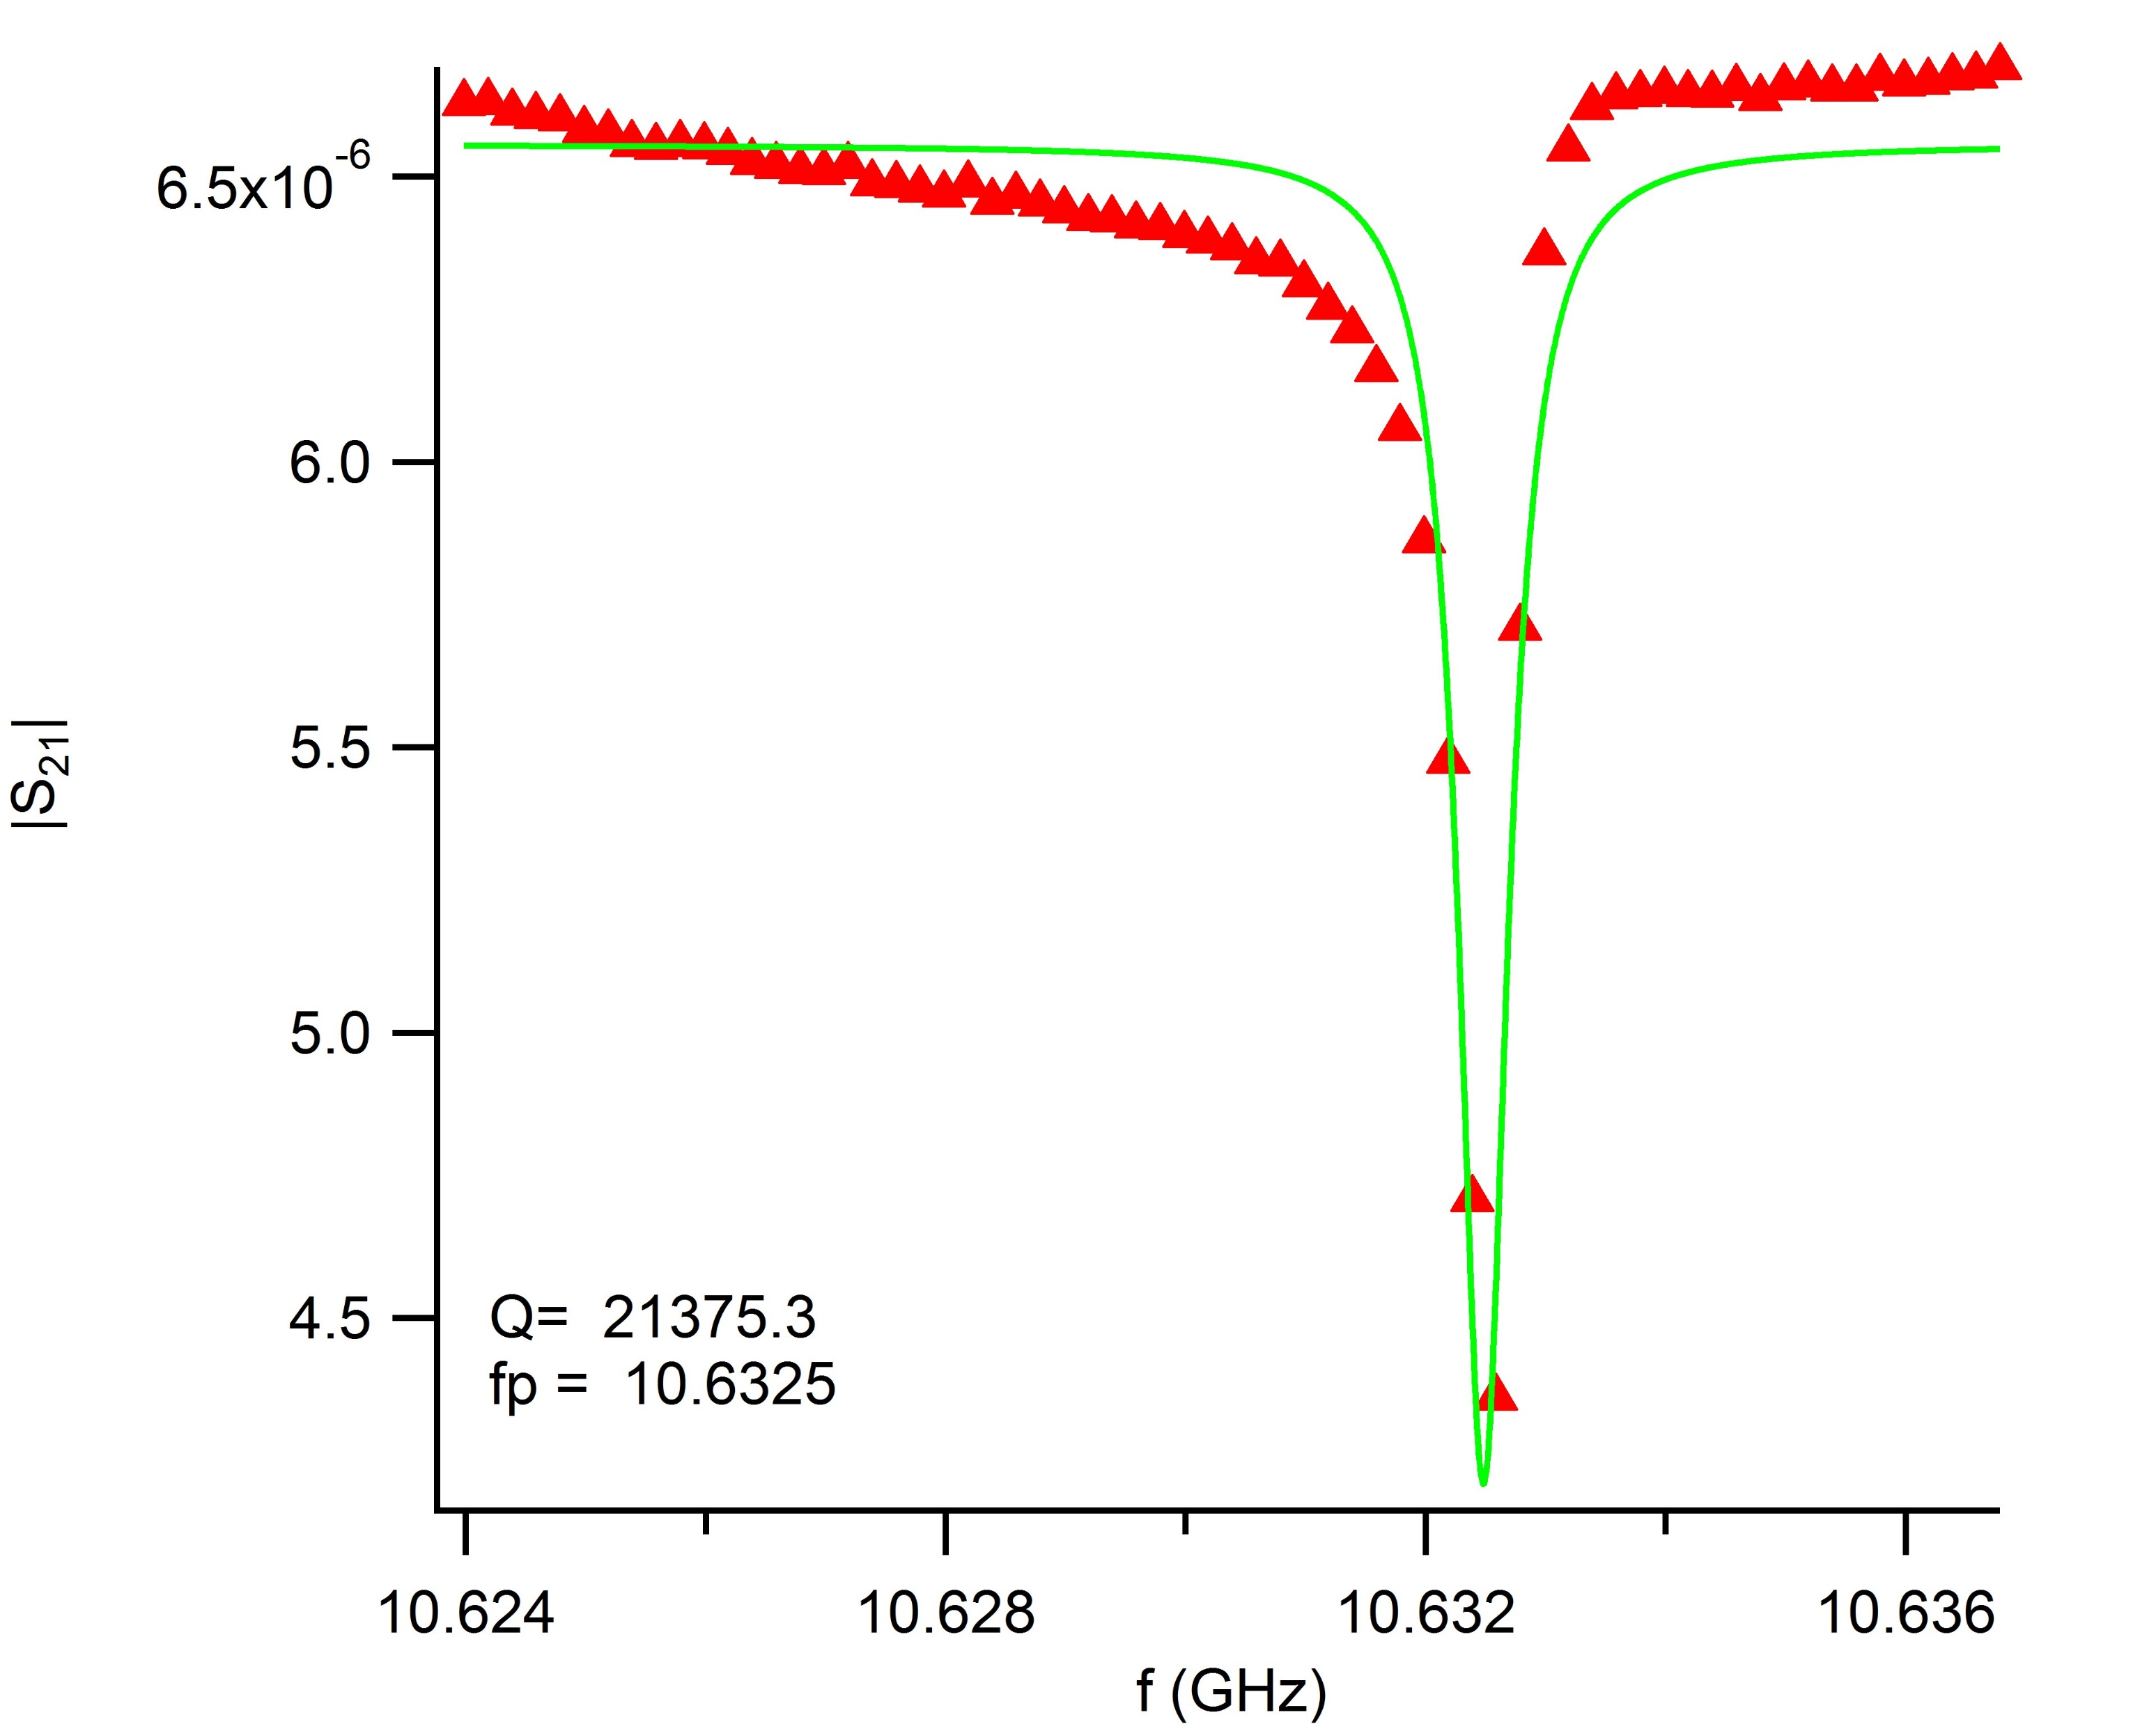
High Q Resonator Chip (resonator 5 and 6)

Slide 40
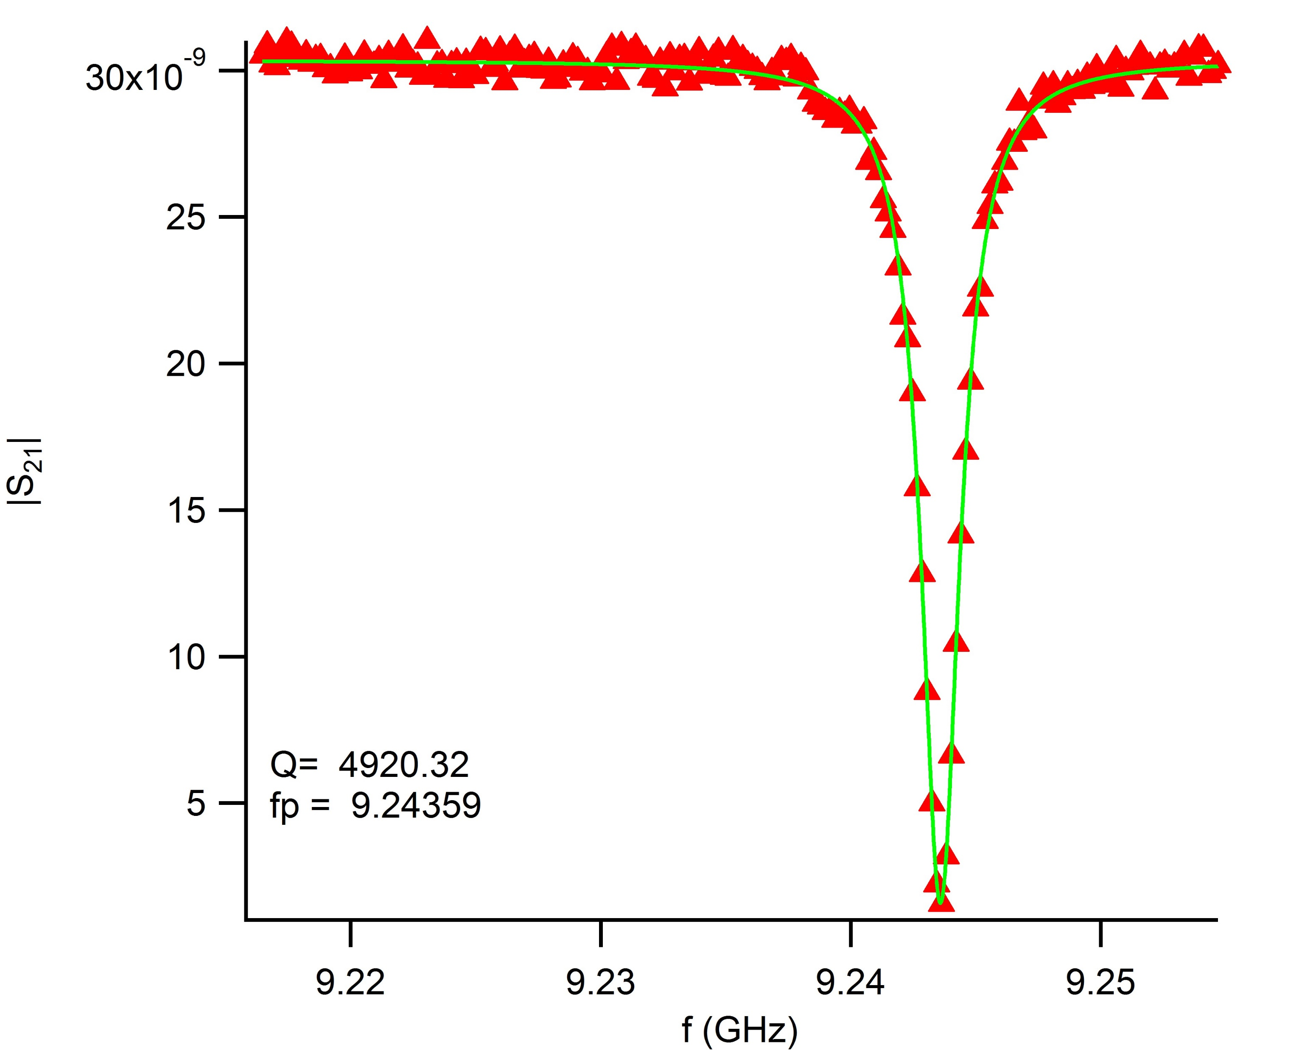
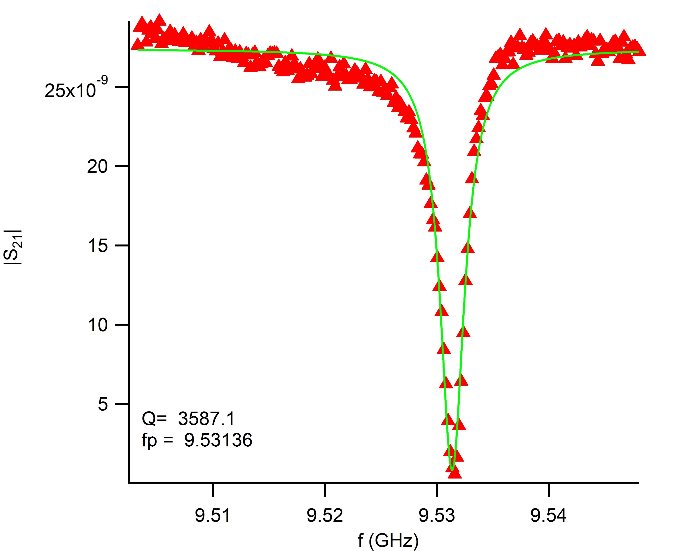
Low Q Resonator Chip 1 (resonator 1 and 2)

Slide 41
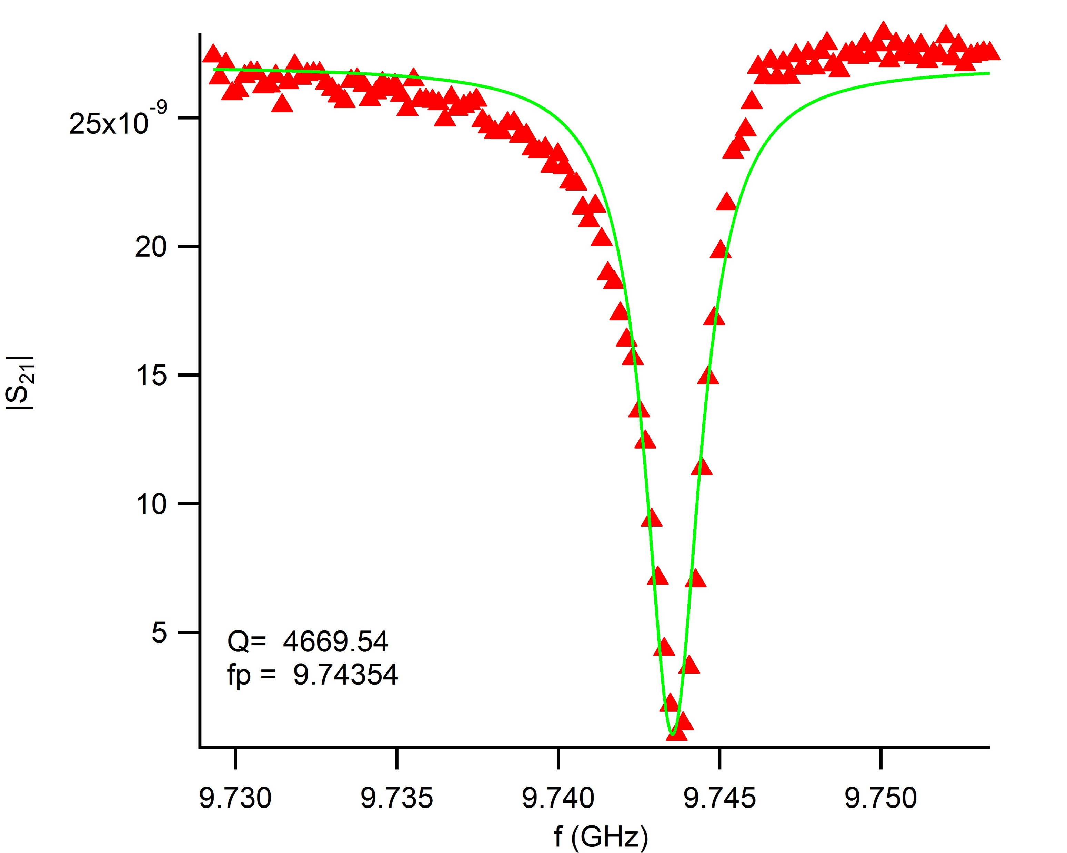
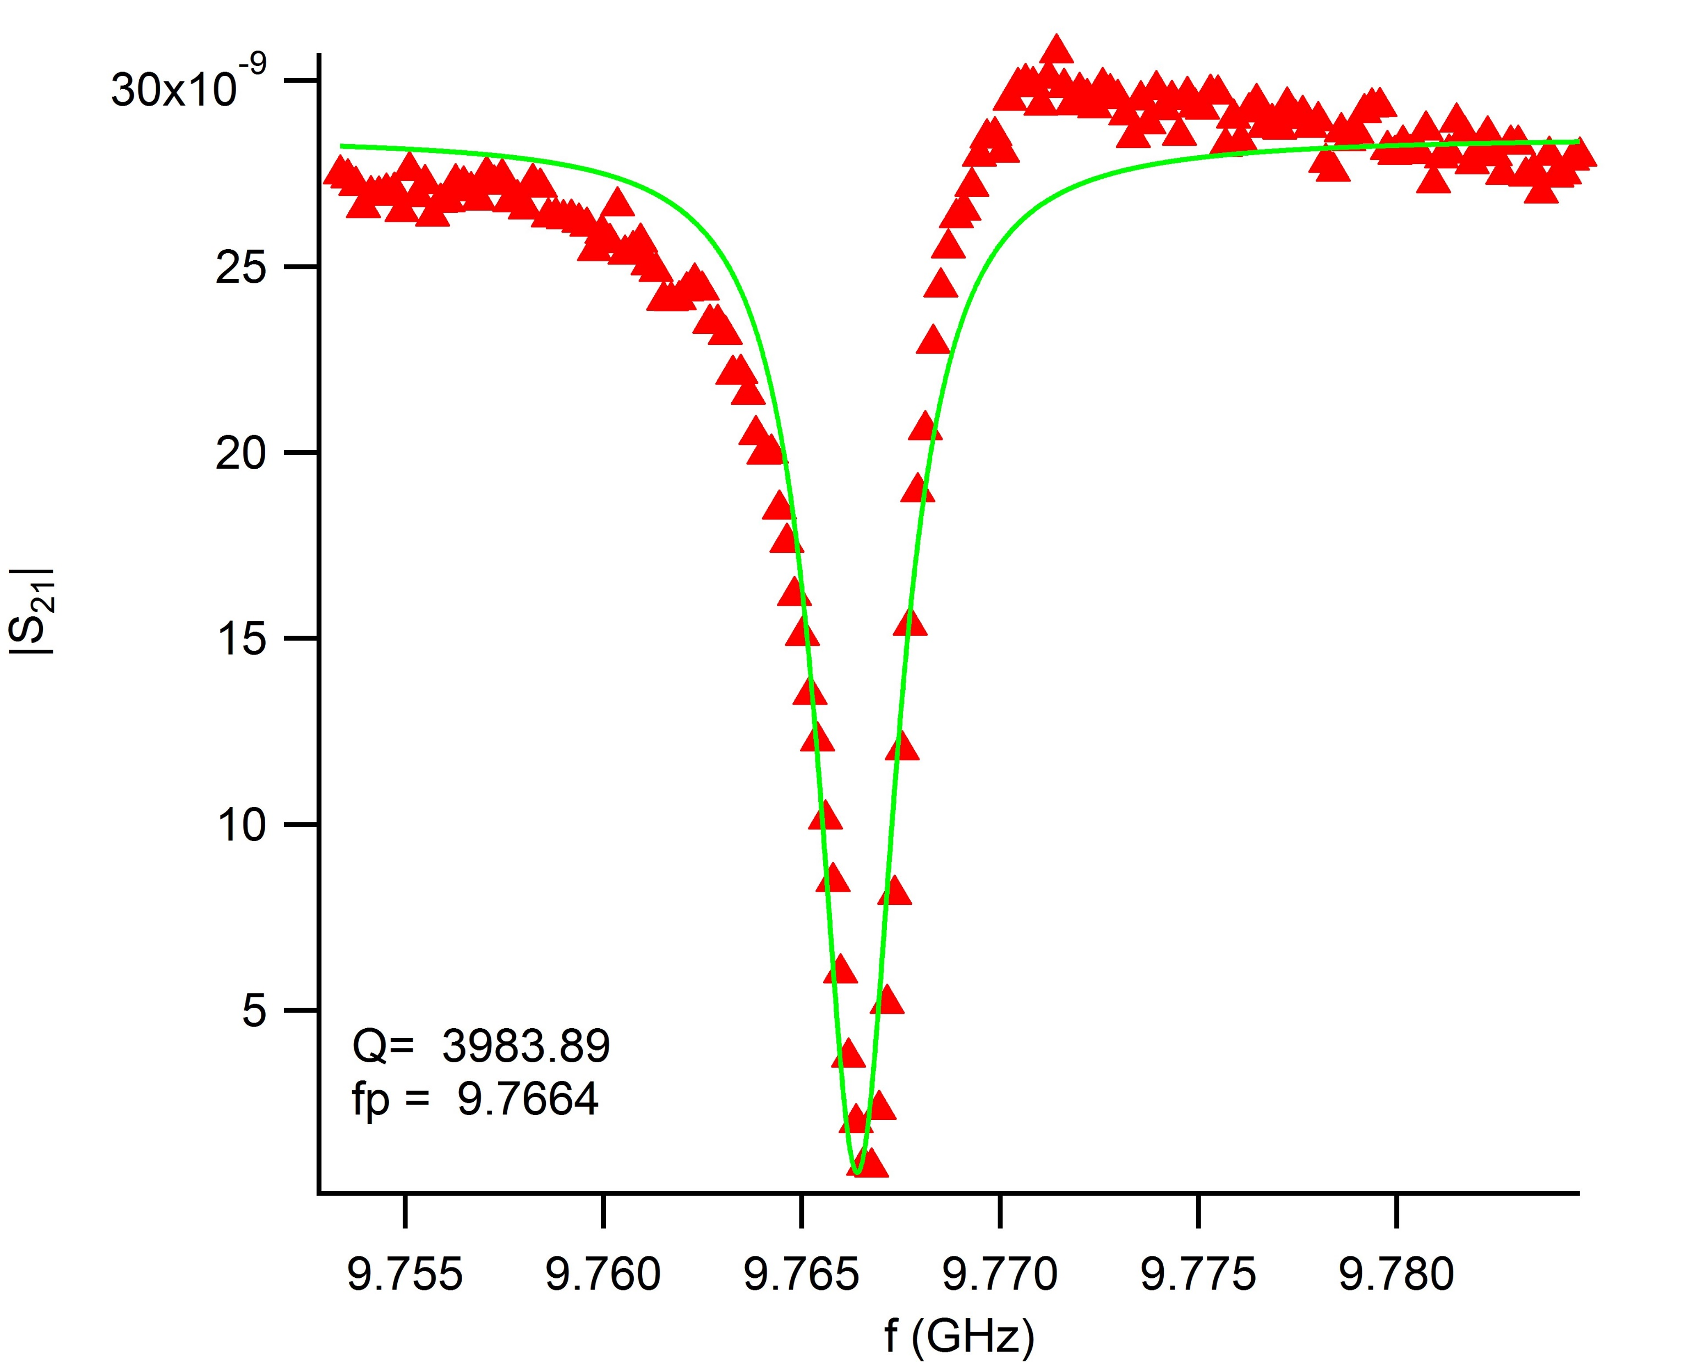
Low Q Resonator Chip 1 (resonator 3 and 4)

Slide 42


Low Q Resonator Chip 1 (resonator 5 and 6)

Slide 43

Low Q Resonator Chip 2 (resonator 1 and 2)
The missing resonance in the low Q resonator chip 2 spectrum attributed to the shorting in the fab (explained in an earlier slide)

Slide 44


Low Q Resonator Chip 2 (resonator 3 and 4)

Slide 45


Low Q Resonator Chip 2 (resonator 5 and 6)

